Slide 1

Thank You for Joining!
The meeting will start shortly

Slide 2
September 2021 Service Change & Fare Policy Meetings
Thursday, August 19th, 2021 at 6pm
Tuesday, August 24th, 2021 at noon

Slide 3
Meeting Purpose
Thank you for joining us and participating
in this community discussion.
The purpose of this meeting is to provide you with an update on upcoming service changes.
COTA will also present final recommendations for adjustments to its fare policy.

Slide 4
Meeting Format
We are recording this meeting. The recording will be posted on our website at COTA.com. If you are joining us my computer or phone, please know we cannot see or hear you. During the meeting, please ask questions and submit comments via the Q&A Chat. Please be considerate of meeting attendees and COTA staff.
HOW COMMUNICATE WITH COTA!
If joining by the computer, submit comments via the chat box. If joining by the phone, please wait to unmute yourself until directed by the moderator. If joining by Facebook Live, please submit your question by commenting in the livestream.

Slide 5
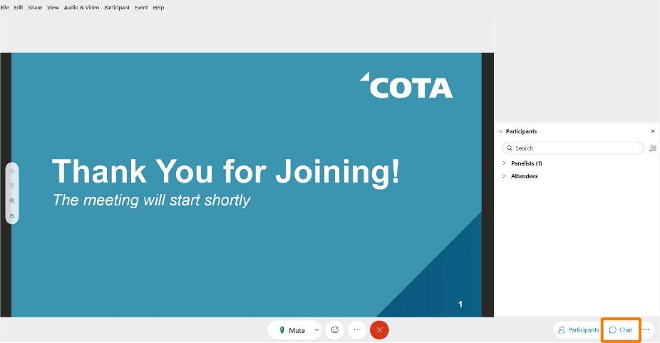

Locate and select the Chat button at the bottom right corner of your screen
How to Use Q&A Chat
\+
032\+
HOW TO USE Q&A CHAT

Slide 6
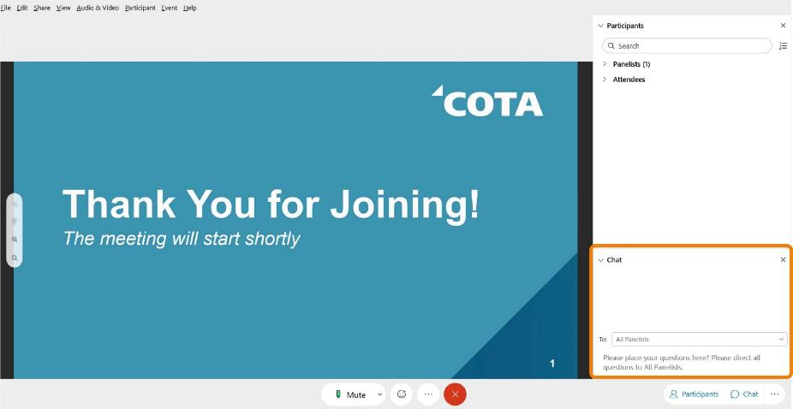

In the ‘To’ drop-down list, select ‘All Panelists’
How to Use Q&A Chat

Slide 7
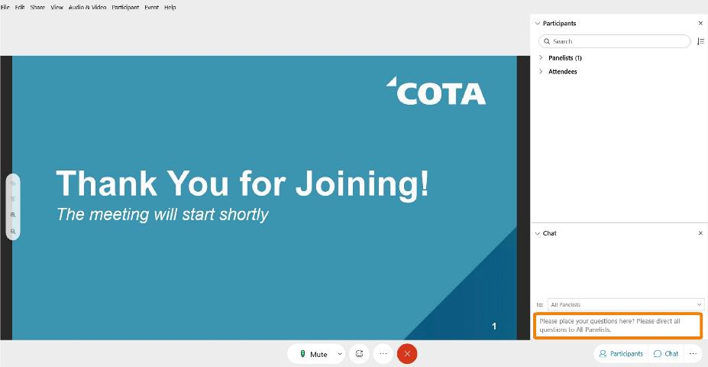

Enter your question in the chat text box and press Enter on your keyboard
How to Use Q&A Chat

Slide 8
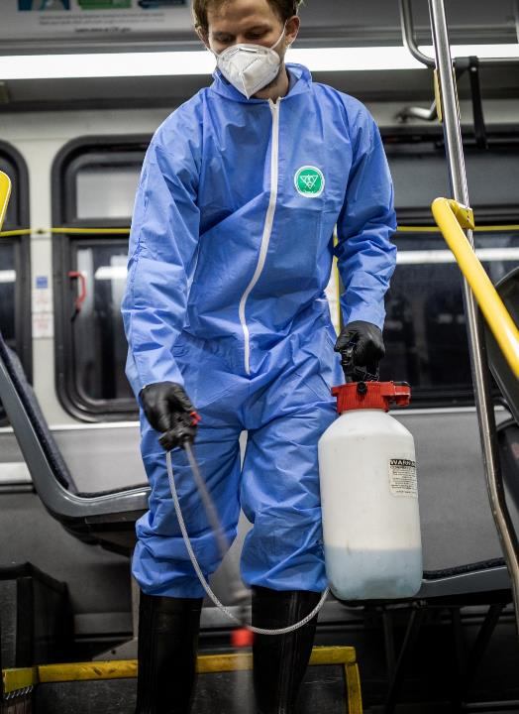
COVID-19 Policy Updates
How is COTA keeping customers and employees safe?
COTA will continue to follow federal laws which still require masks to be worn on all transit vehicles.
COTA will also continue to provide the following measures to keep customers and employees safe:
Cleaning and sanitization on all transit vehicles and at high ridership stops
Installed operator barriers on fixed-route fleet
Proper ventilation
Hand sanitizer

Slide 9
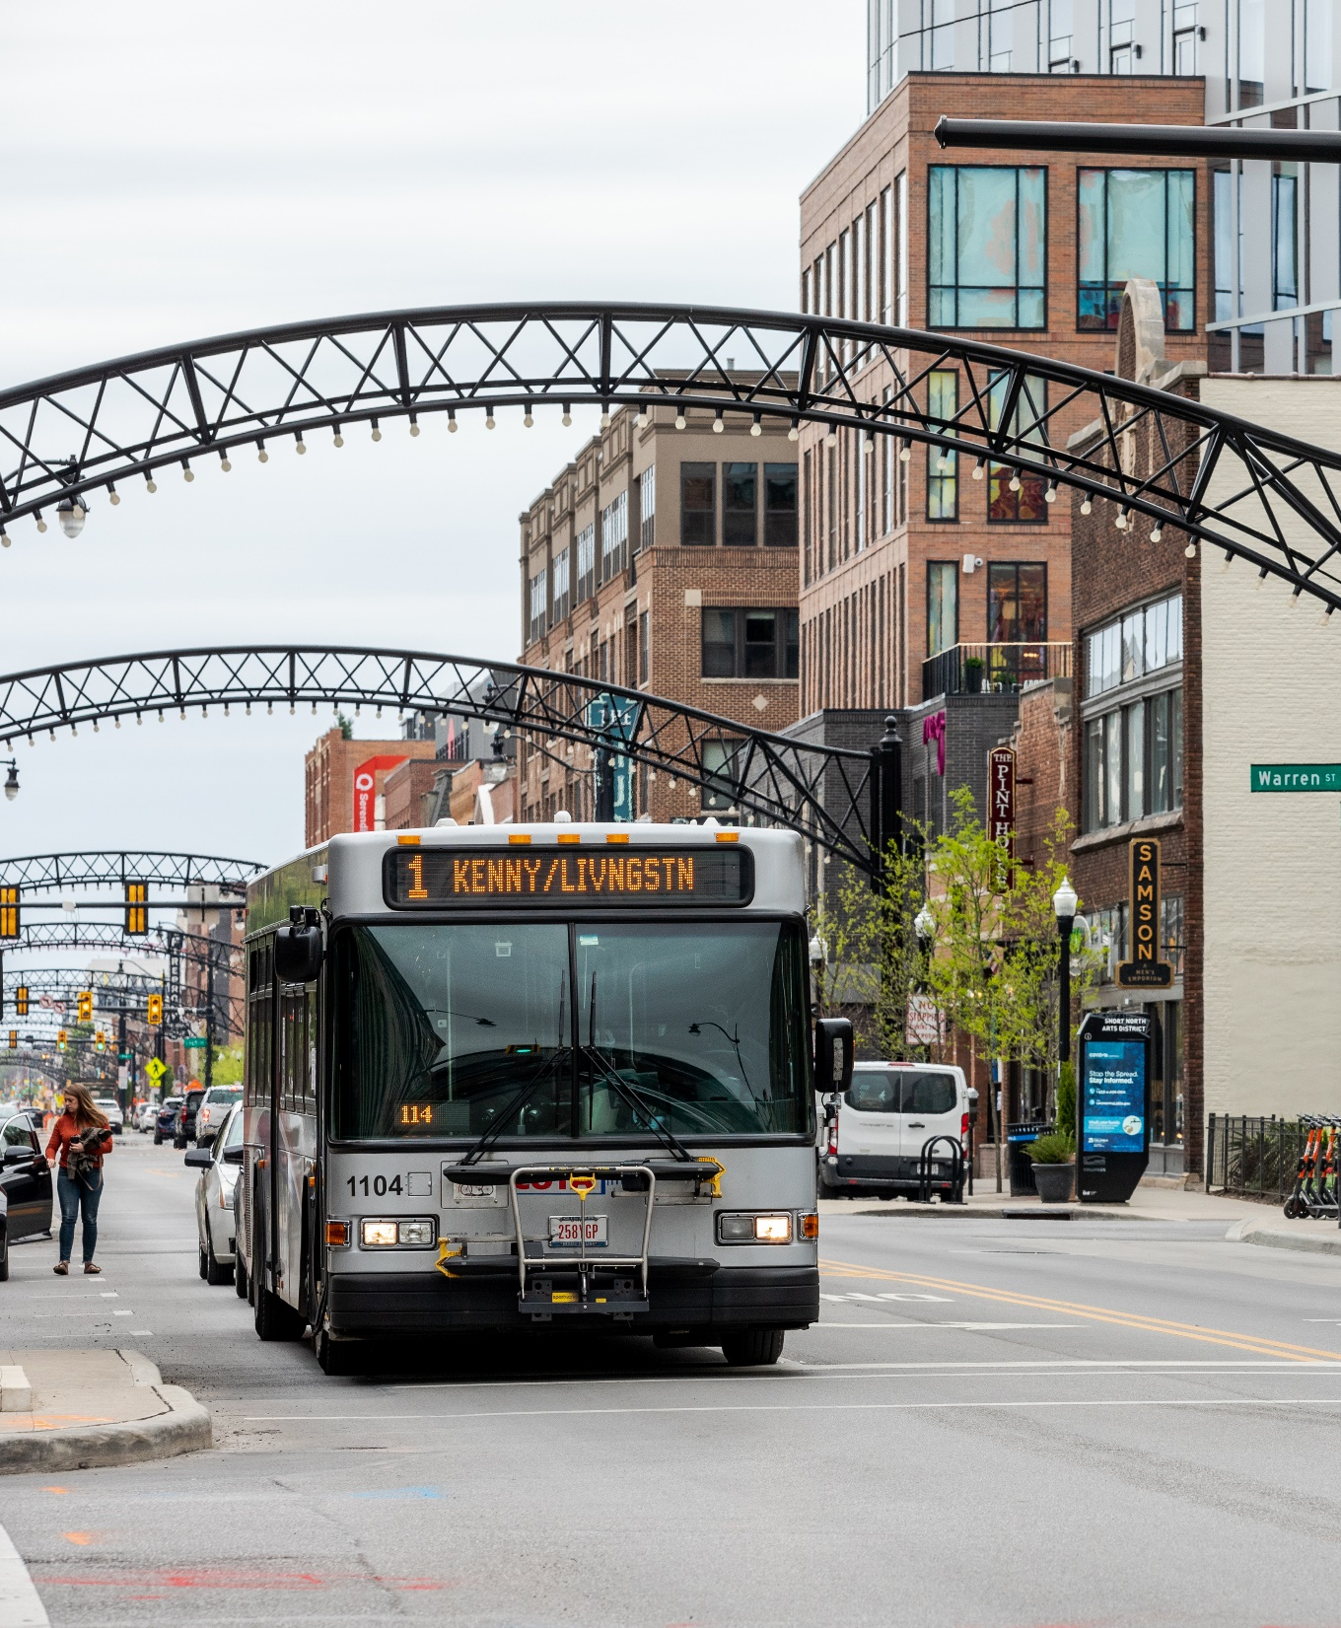
Service Adjustments Postponed
COTA is experiencing a shortage of operators, which is impacting current service. Unfortunately, this is also delaying the implementation of changes scheduled for Monday, September 6, 2021.
COTA is developing a plan to address the staff shortage and prioritize service where it is most needed. This plan will first be shared with our team and then with the public at a later date.
We apologize for the delay in information. You can get the latest service information at COTA.com or by calling COTA Customer Care at 614-228-1776.

Slide 10
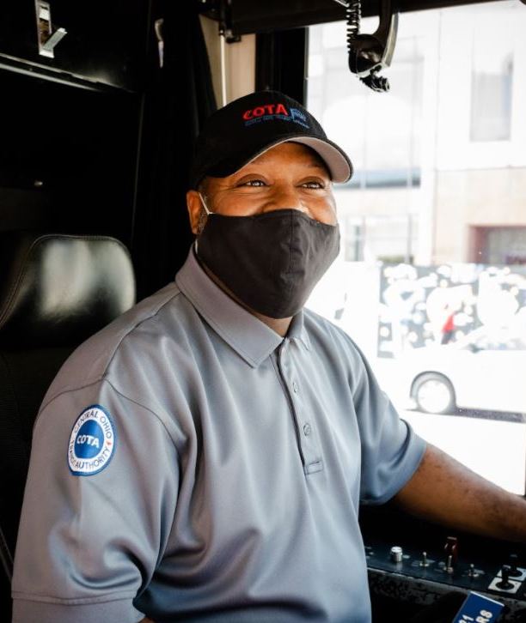

COTA is Hiring Operators
COTA is actively recruiting, hiring and training new operators. Anyone interested in a rewarding career at COTA can learn more and apply at COTA.com.
Service Requests
COTA will continue to document requests for service and work to restore service hours.

Slide 11
UPCOMING SERVICE ADJUSTMENTS
The following service adjustments will begin on Monday, September 6, 2021, changes will include alignment and scheduling modifications.

Slide 12
SERVICE CHANGES
The upcoming service changes will take effect starting Monday, September 6, 2021. The changes will include scheduling adjustments & alignment modifications to the following lines:
Summary of Changes
LINES | LINE NAME | CHANGES
1 | Kenny/Livingston | Scheduling & alignment adjustments
2 | E Main/ N High | Scheduling adjustments
4 | Indianola/Lockbourne | Scheduling & alignment adjustments
5 | W 5th Ave/ Refugee | Scheduling & alignment adjustments
8 | Karl/ S High/Parsons | Scheduling & alignment adjustments
9 | W Mound/Brentnell | Scheduling & alignment adjustments
13 | Arlington/ 1st Ave | Adding one weekday AM/PM peak trip
LINES | LINE NAME | CHANGES
42 | Sharon Woods | Adding one weekday AM/PM peak trip
44 | Easton | Adding one weekday AM/PM peak trip
45 | New Albany | Adding one weekday PM peak trip
46 | Gahanna | Adding one weekday AM/PM peak trip
51 | Reynoldsburg | Alignment adjustments
74 | Smoky Row | Adding one weekday AM/PM peak trip
Zoo Bus |  | Will operate Friday, Saturday, and Sunday only until Oct.31

Slide 13
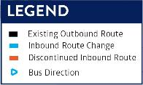
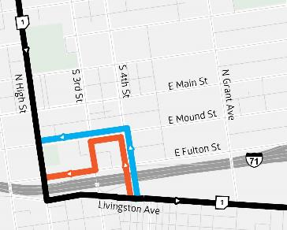
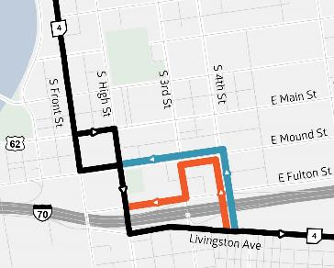
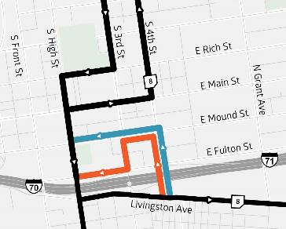
SERVICE CHANGES
Lines 1, 4, 8 Realignment
Due to ongoing construction on E Fulton Street, Lines 1, 4, and 8 will head north on S 4th Street, west on E Mound Street, and north on High Street heading into downtown Columbus. Change will provide a simple, more direct route between Livingston Avenue and High Street.
Line 1 Kenny/Livingston
Line 4 Indianola/Lockbourne
Line 8 Karl/S High/Parsons

Slide 14
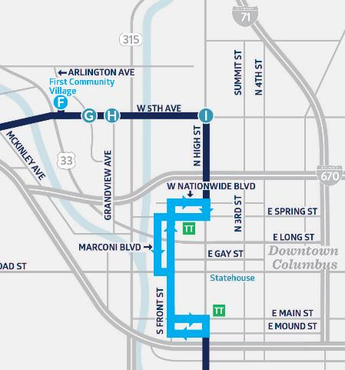
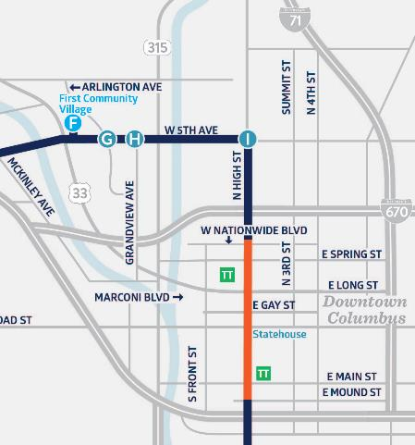
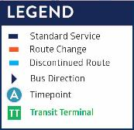
SERVICE CHANGES
Line 5 will move to High Street in both directions in downtown Columbus. The change will provide a simple, more direct route through Downtown.
Line 5 Realignment
Line 5: Discontinued Downtown Alignment
Line 5: New Downtown Alignment

Slide 15
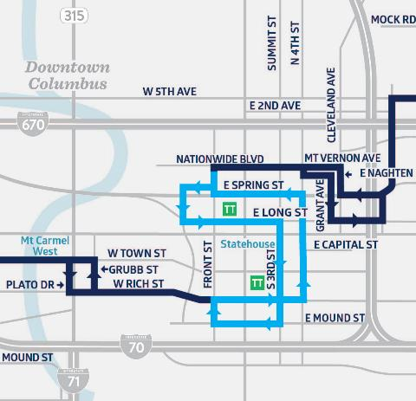
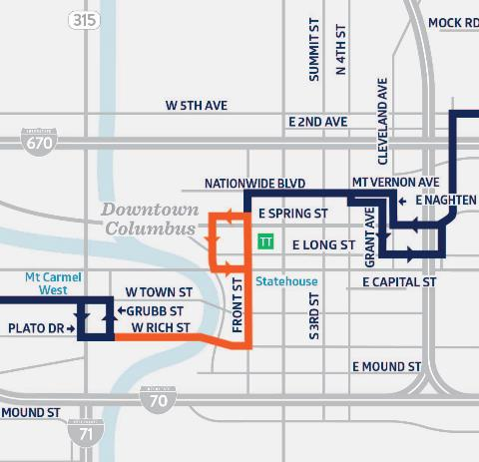
SERVICE CHANGES
Line 9 will move to Front Street in both directions in downtown Columbus. The change will provide a simple, more direct route through Downtown.
Line 9 Realignment
Line 9: Discontinued Downtown Alignment
Line 9: New Downtown Alignment

Slide 16
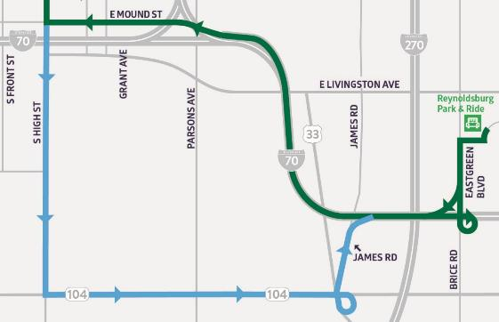
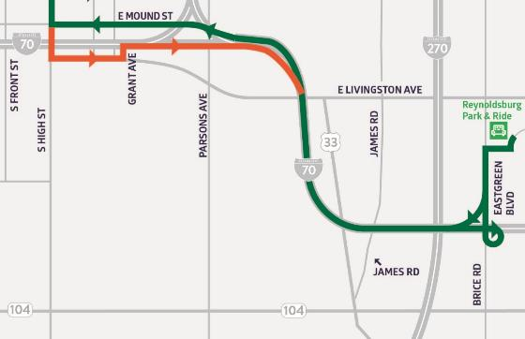
SERVICE CHANGES
Line 51 will move to Livingston Avenue in the eastbound direction heading to Reynoldsburg. The change will provide a more direct route exiting Downtown.
Line 51 Realignment
Line 51: Discontinued Downtown Alignment
Line 51: New Downtown Alignment

Slide 17

Zoo Bus Service
The Zoo Bus operates on Labor Day! Beginning Monday, September 6 and lasting through October 31, the Zoo Bus will operate on Friday, Saturday and Sundays only.
For more information about COTA Zoo Bus service, visit COTA.com/ZooBus or call (614) 228-1776. For Zoo
and Zoombezi Bay hours, visit columbuszoo.org.

Slide 18
Question & Answer Chat
Have a question about the service changes?
If joining via Webex, submit comments via the chat box.
If joining via the phone, please wait to unmute yourself until directed by the moderator.
If joining via Facebook Live, please comment your questions
in the livestream.
Visit www.cota.com/contact to suggest how we can improve COTA’s service.
Coming up next: Fare Policy & New Fare Payment System

Slide 19
Fare Management System Upgrade & Fare Changes under Consideration
August 2021

Slide 20

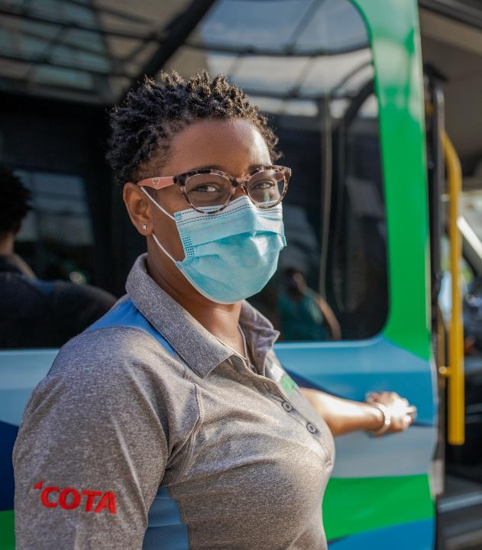
Agenda
Fare Management System Upgrade
Fare Changes Under Consideration
Questions/Answers and Public Comment

Slide 21
Meeting Format
If you are joining by computer or by phone, please know that you are muted, and we cannot hear or see you. During the meeting, please ask questions and submit comments via the Q&A Chat. We will answer them at the end of the presentation.
If you have questions and are joining by the phone, we will ask you to unmute yourself when the presentation is finished.
If joining in person, we will address any questions or comments at the end of the presentation
Please be considerate of meeting attendees and COTA staff.

Slide 22
Fare Management
System Upgrade

Slide 23





Fare Management At A Glance
PROGRAM
PARTNERS
In December 2020, the COTA Board of Trustees approved a contract with Masabi for a modernized fare payment system to achieve critical equitable outcomes:
Digital payment using account-based ticketing via Transit App or smart card that provides peace of mind for customers
Fare capping to create payment equity no matter how often a customer rides
A robust third-party retail network putting COTA within the neighborhoods for those who use us most
Project Timeline 2021
August
November
September
October
Pilot Phase 100+ participants
Public Launch
Initial Messaging Launch
Marketing Campaign
Notes:
INITIAL DRAFT PRESENTATION TEXT WITH ANGEL’S EDITS:
COTA is planning for the implementation of a new electronic, account-based fare collection system for late 2021 (4th Quarter)
The goal is to increase access and flexibility in how Customers pay their fares, while providing a seamless payment experience.
The fare management system is a major first step as COTA promotes electronic fare payments and reduce the use of cash.
This effort is driven by COTA’s commitment to providing access to safe and affordable transit, with a focus on ease of use and inclusivity to all customers.
The new fare management system will replace COTA’s current passes issued and swiped at the farebox
After the initial launch, COTA will begin working on transitioning its other programs (such as C-Pass) to the new system.

Slide 24
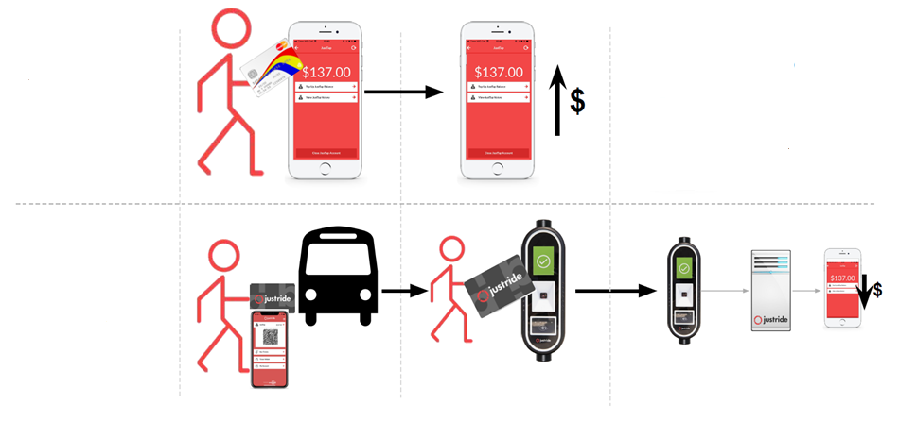




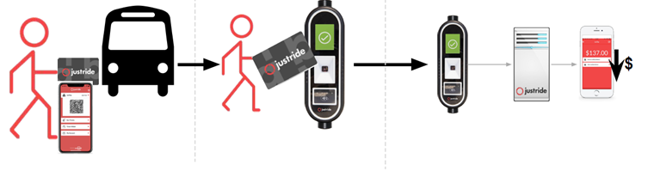





Account-Based Ticketing
Protecting Customers - an account-based system is safer than carrying cash and ensures customers get the best value on every trip!
Customers add funds to their account in the app
Other ways to add funds:
COTA.com
Retail Network Locations
Customer Experience Center
Customer taps smart card or app on on-board validator
Fare is deducted from account
$
Notes:
INITIAL DRAFT PRESENTATION TEXT WITH ANGEL’S EDITS:
With the account-based ticketing system, customers will be able to add funds to their account that is tied to either a mobile device or a reusable smart card.
Customers will then use the pass to pay their fare by scanning a barcode on their phone or tapping their smart card on a validator
This slide provides an example of what COTA customers will see in the Transit App.
Customers will be able to plan their trip, check bus arrival, set up an account, add funds to their account and pay their fare directly using the Transit App.

Slide 25
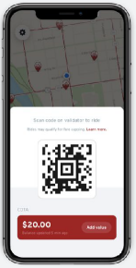
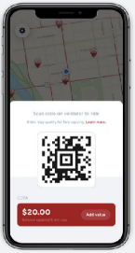
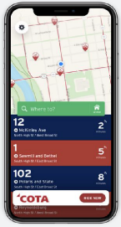
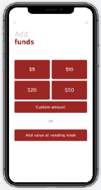
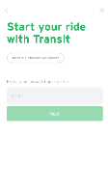
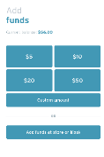
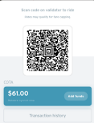



Customer Experience
The new system will launch in Winter 2021.
Loading Funds and Ticketing
How would a customer use the new system?
Payment in the Transit App
Customers can use smartphone or smart card to pay their fare
Check
bus arrival
Set up an account
Add funds
Pay and go
Notes:
SAME INFORMATION AS PREVIOUS SLIDE BUT GOOD FOR REFERENCE.
With the account-based ticketing system, customers will be able to add funds to their account that is tied to either a mobile device or a reusable smart card.
Riders will then use the pass to pay their fare by scanning a barcode on their phone or tapping their smart card on a validator
This slide provides an example of what COTA customers will see in the Transit App.
Riders will be able to plan their trip, check bus arrival, set up an account, add funds to their account and pay their fare directly using the Transit App.
INITIAL DRAFT PRESENTATION TEXT WITH ANGEL’S EDITS:
Riders would scan a barcode in the Transit App or tap their smart card to pay the fare at the on-board validator
Once the ride scans their phone or taps the smart card on the on-board validator, the appropriate fare will be deducted from their account.
The validator will then provide confirmation on the screen, through an audible beep and a green light that the fare has been accepted.
All validators will be consistently mounted on the right hand side when entering the vehicle.

Slide 26
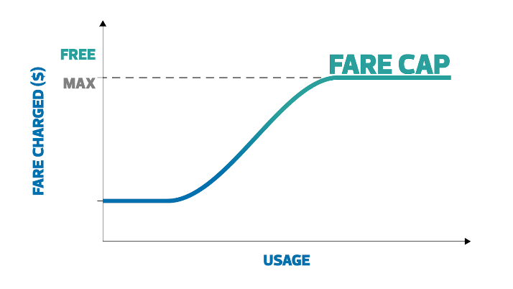



Fare Capping
Provides the customer the best fare for their journeys for the day and calendar month.
NO FARE CAPPING
Pays $2.00 cash each trip
Rides 4x/day on average
NO ADDITIONAL CHARGE
Spends $8.00 total each day
WITH FARE CAPPING
Digitizes cash and uses mobile or smart card to pay $2.00 fare
Rides 4x/day on average
Pays no more than $4.50 total each day
Notes:
The new fare collection system supports fare capping, which is a strategy that would increase affordability and convenience, and promote transit ridership.
For many customers the upfront cost of 31-day pass or even a 7-day pass may be a barrier
Fare Capping enables a customer to pay towards a pass in increments, and fares are capped once a customer has paid the equivalent of a day or monthly pass.
Essentially, a customer can expect to spend no more than $62, the price of a monthly pass, on fixed route service in any given month.
*Walk through of the example of Fare Capping with a Daily Pass.
By enabling a customer to pay towards a pass, the need to offer 7-day and 31-day pass for most customers would be eliminated

Slide 27
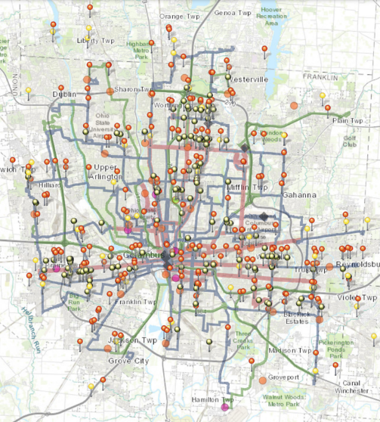








Retail Network
Customers will be able to easily digitize cash and add money to their COTA account at over 400 potential locations such as Speedway, Walgreens, Family Dollar, and more.
In-App / Web
In-Person
ACQUISITION
ENGAGEMENT
Customer generates barcode
(Digital)
Visits Participating Store
Presents account funding barcode to the cashier for scanning
Hands over cash or approved tender type
Cashier processes payment
Customer receives receipt
Account is credited immediately
New retail locations - 363% increase
Notes:
INITIAL DRAFT PRESENTATION TEXT WITH ANGEL’S EDITS:
For those customer that don’t have access or ability to add funds onto their account through the app or website using credit or debit card, there will be approximately 400 retail locations where people can visit to load funds to their accounts using cash.
These retail networks also process payments and digitize cash for other providers such as mobile carriers, Amazon, and utility companies, so this technology is already being used by many customers.
This is a significant expansion from the 10 existing locations where passes are currently sold. The 400 retail locations will be determined based on COTA’s analysis of community needs. COTA is working with payment network vendors incomm and TCetra to ensure there is sufficient coverage throughout the Central Ohio region. expand this network. Some retail locations in which customers will be able to do this include CVS, Walmart, Speedway as well as many smaller independent retailers.
For customers loading cash at a retail location, the customer will take their fare media to a participating store
The customer will generate barcode either in the Transit App on their mobile device or show the barcode on their smart card to the cashier
The cashier will then will scan to pull up the account.
The customer will provide cash payment to the cashier who will then load the funds to the customer’s COTA account.
Customers will then be able to use their mobile account or smart card and scan their fare at the on-board validator

Slide 28
Fare Changes
Under Consideration

Slide 29
Fare Changes under Consideration
No Fare Increase Being Considered
Proposed Changes
November 2021 (estimated) 2-Hour Passes Flat Fare Fare Capping Other changes being considered One Discount Fare Program Children Under 5 Ride at no cost
Fare Media and Retail Changes
November 2021 (estimated) Introduce New Fare Media and Retail Network Discontinue Sale of Paper Multi Ride Tickets and 7-Day Passes at Current Retail Network and TVMs 2022 (estimated) Discontinue Sale of Paper Single Ride Tickets, Day Passes, and 31-Day Passes at Current Retail Network and TVMs
Future Changes Under Consideration
Low-Income Eligibility for Discount Fare Nonprofit Program Special Event Discontinue Cash Transfers and Onboard Day Passes
Notes:
In preparation of the launch of the new fare system, COTA initiated a fare study at the end of 2020 with the objective of evaluating its fare policy and structure
The study included evaluation of current fare system and identification of opportunities to improve and simplify COTA’s fares
As required by federal law, we are conducting public outreach to obtain public feedback on the the proposed changes
In addition, we are conducting a Title VI fare equity analysis to understand whether the proposed changes would result in a disparate impact on minority populations or a disproportion burden on low-income populations
We are working to coordinate this project with the fare collection project as much as possible to provide customers the best possible experience
The technology available with the Masabi system allows us to offer many of the fare changes that we will discuss today. That is why these two points are so closely tied together.
These are fare changes under consideration;
It is important to stress that THERE IS CURRENTLY NO FARE INCREASE BEING CONSIDERED.
The new fare collection system greatly increases COTA’s flexibility in enacting new fare strategies to meet the needs of its customers today and into the future
In the near term, COTA is exploring the implementation of 2-Hour passes in lieu of the current transfer policy, flat fares to simplify the fare structure, and fare capping to increase affordability.
In 2022 and beyond, COTA is considering introducing low-income fares to minimize barriers to transit and increase accessibility,
COTA is also exploring discontinuing cash transfers as well as onboard day passes to improve operational efficiency.
In addition to these, as part of the review of COTA’s fare policies, COTA identified supporting strategies that we believe would enhance the overall customer experience
There are also new opportunities available with the new fare management system to support and introduce new fares and pass programs

Slide 30


2-Hour Passes
Replace one-way transfers valid for 2 hours with 2-hour passes
A 2-Hour Pass provides customers unlimited access to COTA bus services within 2 hours.
Simplifies transfer policies
Easy to understand
Greater flexibility
Cost-effective
Potential revenue loss from customers who are able to complete a round-trip within 2 hours
Notes:
Replace one-way transfers valid for 2 hours with 2-hour passes
Currently, transfers have directional limits. Two hour pass would simplify transfer policies and make them easier to understand while providing greater flexibility.
With this change, customers will be able to access unlimited travel to COTA bus services within 2 hours providing greater flexibility and more cost-effective option to complete errands within two hours and link errands.
A limitation of the change is that the transition to 2-hour pass would only be available for those paying with electronic transfers; cash transfers issued from the farebox would still have embedded roundtrip restrictions
While there is potential for revenue loss from customers who are able to complete their trip within 2 hours, the new policy may encourage new transit trips as transit becomes a more cost-effective option

Slide 31
Flat Fare
Eliminate Rush Hour fare upcharge
A Flat Fare structure charges the same amount regardless of the type of fixed route bus used.
Simplifies fare structure - making it easier to understand and implement
Limits complexity in fare capping
Benefits customers who transfer between services
Slight revenue loss
Notes:
Eliminate Rush Hour fare upcharge resulting in a flat fare structure
All full fare regular customers using fixed route would pay $2 regardless of the service they use
This change simplified the fare structure, making it easier to understand. No more paying upgrades when transferring between services or determining which type of pass to purchase
It would make it easier to implement using the new fare management system and would limit complexity in fare capping
While benefiting those who transfer between services, as all services will now cost the same, and no upcharge required
This change may lead to a slight loss in revenue. However they make up a small proportion of COTA fixed route ridership

Slide 32

Fare Capping
Introduce daily and monthly fare capping; discontinue 7-day and 31-day passes
Fare Capping enables a customer to pay towards a pass in increments, and fares are capped once a customer has paid the equivalent of a day or monthly pass.
A customer is guaranteed to never spend more than $62.00 in a month on fixed route services.
Example of Daily Fare Capping
COTA’s 2-hour pass costs $2.00 with a Day Pass priced at $4.50 and a Monthly Pass priced at $62.00
1st trip: $2.00 charged
2nd trip: $2.00 charged
3rd trip: $0.50 charged
Total fare collected for day: $4.50
Additional travel that day is at no additional cost
Once customer pays $62 in the month, additional travel that month is at no extra cost
Requires convenient access to load stored value frequently
Notes:
The new fare collection system supports fare capping, which is a strategy that would increase affordability and convenience, and promote transit ridership.
For many customers the upfront cost of 31-day pass or even a 7-day pass may be a barrier
Fare Capping enables a customer to pay towards a pass in increments, and fares are capped once a customer has paid the equivalent of a day or monthly pass.
Essentially, a customer can expect to spend no more than $62, the price of a monthly pass, on fixed route service in any given month.
*Walk through of the example*
By enabling a customer to pay towards a pass, the need to offer 7-day and 31-day pass for most customers would be eliminated

Slide 33
Fare Capping
Introduce daily and monthly fare capping; discontinue 7-day and 31-day passes
Improves affordability of passes
Provides customers with the “best fare”
Encourages transit use
Ease of use - pay as you go
Encourages electronic fare payment improving operations
Riders must have a smartphone or smart card and add funds to their accounts to benefit
Potential revenue loss
Complexity - takes time to explain the concept to customers
Eliminates 7-day and 31-day passes sold at current retail locations and TVMS
Notes:
Fare capping increases affordability by eliminating the need to purchase a pass upfront, it provides customers with the “best fare” and encourages transit use by making it easy to use - just pay as you go and know that your fares are capped at $62 for the month
Since fare capping is only available on mobile payment or smart card, it encourages electronic fare payment improving operations by reducing the time it takes customers to pay their fare when boarding compared to paying cash or activating and swiping a pass at the farebox
While fare capping does provide a lot of benefits for customers, it does require customers to have a smartphone or smart card and add funds to their accounts to benefit, which can pose an equity concern if customers don’t have access to the fare media and the retail network
COTA is committed to make sure customers have access to the fare management system - many customers will have the fare media in their pockets already with a compatible smartphone - COTA is also focused on making sure that customers have ability to load cash to their accounts conveniently at retail locations and not just accepting online payments
By providing all customers paying with electronic fare media the best fare, COTA anticipates potential revenue loss and at this time is able to implement fare capping without increasing fares given reserves and federal funds to help the agency recover from COVID
As COTA implements fare capping, it will be important for COTA to develop a clear communication plan to explain how fare capping. There are great lessons to be learned from other agencies, such as Dayton RTA that are implementing fare capping
While COTA would discontinue 7-day and 31-day passes as part of implementing fare capping, COTA is working with community partners, such as nonprofits and social service agencies, to understand potential alternatives to meet their clients transportation needs

Slide 34
Other Changes
One Discount Fare Program | Streamline application process and eliminate Senior/Key distinction
Simplification of “Child” Definition & Criteria | Replace 48” height limit with age limit (under 5 years of age) Eliminate limit of three children per adult
Notes:
One Discount Fare Program would streamline the application process and eliminate the distinction between senior and key IDs.
During the current state analysis of COTA’s fare structure, the confusion regarding when children ride at no cost was identified
Currently, up to three children under 48” ride at no cost with an adult. The height is based on the height of the farebox to assist the operator to determine eligibility for no fare.
Under the proposal, children under 5 years of age would ride at no cost with an adult. There would be no limit on the number of children
Children 5-11 years of age would still be able to pay the discounted reduced fare
**If asked, Operators will make a judgement call with regard to the age of a child. They will error on the side of the child. They will not ask for proof.

Slide 35
Next Steps
August
September
  Public comment process - online, by email, by phone, at public meeting
  Public hearing
  Title VI fare equity analysis report
  Board adoption of proposed fare changes
Notes:
We will continue to share this information throughout August and in September, at the Board meeting where the Board is expected to vote on the proposed changes, they will conduct a public hearing for anyone that wants to comment on the proposal. Additionally, Staff will be providing feedback to the Board based on what we hear at meetings such as this one.

Slide 36
Question & Answer Chat
Have a question about the proposed changes to fare policy or new fare payment system?
If joining via Webex, submit comments via the chat box.
If joining via the phone, please wait to unmute yourself until directed by the moderator.
If joining via Facebook Live, please comment your questions
in the livestream.
Visit www.cota.com/contact to suggest how we can improve COTA’s service.
Thank you!

