Slide 1

Fare Management System Upgrade & Fare Changes under Consideration
July 2021

Slide 2


Agenda
Fare Management System Upgrade
Fare Changes Under Consideration
Questions/Answers and Public Comment

Slide 3
Meeting Format
If you are joining by computer or by phone, please know that you are muted, and we cannot hear or see you. During the meeting, please ask questions and submit comments via the Q&A Chat. We will answer them at the end of the presentation.
If you have questions and are joining by the phone, we will ask you to unmute yourself when the presentation is finished.
If joining in person, we will address any questions or comments at the end of the presentation
Please be considerate of meeting attendees and COTA staff.

Slide 4
Fare Management
System Upgrade

Slide 5
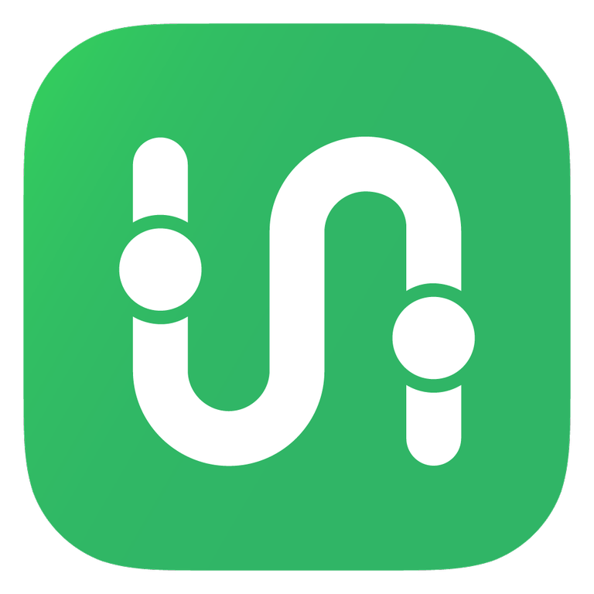




Fare Management At A Glance
PROGRAM
PARTNERS
In December 2020, the COTA Board of Trustees approved a contract with Masabi for a modernized fare payment system to achieve critical equitable outcomes:
Digital payment using account-based ticketing via Transit App or smart card that provides peace of mind for customers
Fare capping to create payment equity no matter how often a customer rides
A robust third-party retail network putting COTA within the neighborhoods for those who use us most
Project Timeline 2021
August
November
September
October
Pilot Phase 100+ participants
Public Launch
Initial Messaging Launch
Marketing Campaign

Slide 6
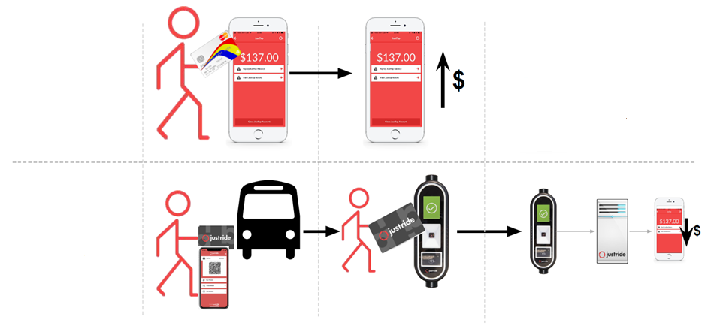
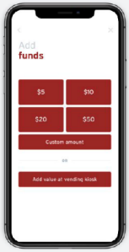
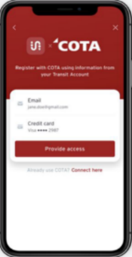
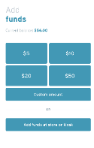
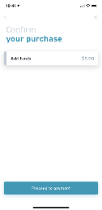
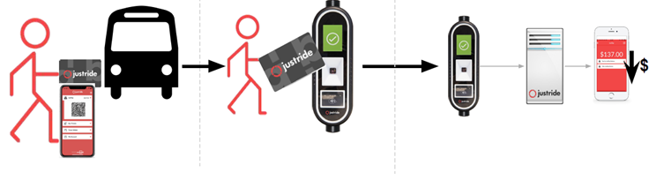





Account-Based Ticketing
Protecting Customers - an account-based system is safer than carrying cash and ensures customers get the best value on every trip!
Customers add funds to their account in the app
Other ways to add funds:
COTA.com
Retail Network Locations
Customer Experience Center
Customer taps smart card or app on on-board validator
Fare is deducted from account
$

Slide 7
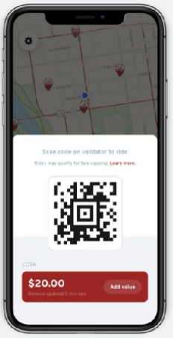

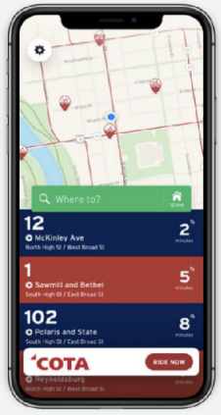

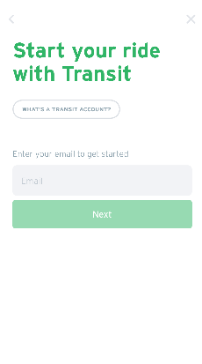
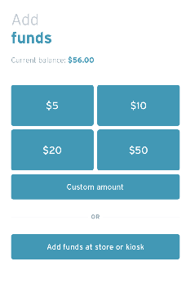
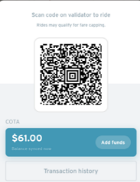
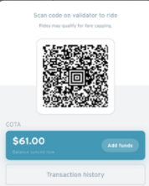


Customer Experience
The new system will launch in Winter 2021.
Loading Funds and Ticketing
How would a customer use the new system?
Payment in the Transit App
Customers can use smartphone or smart card to pay their fare
Check
bus arrival
Set up an account
Add funds
Pay and go

Slide 8
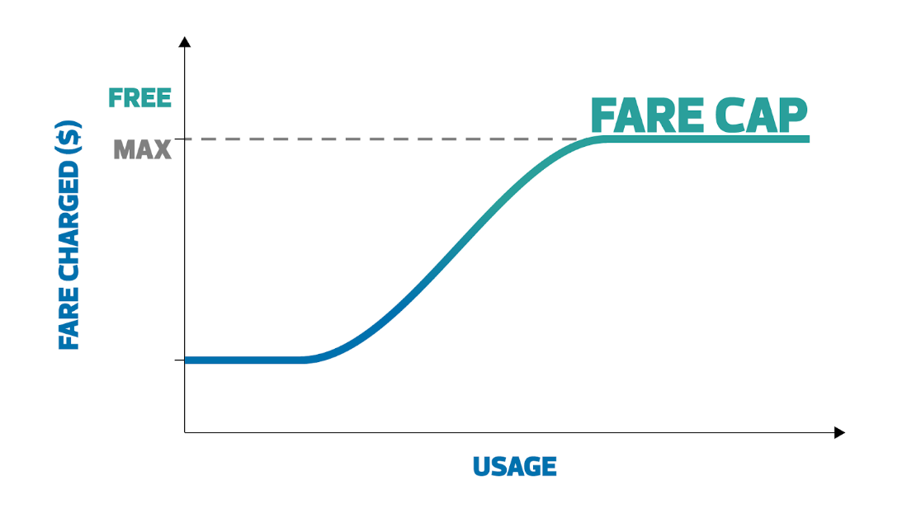



Fare Capping
Provides the customer the best fare for their journeys for the day and calendar month.
NO FARE CAPPING
Pays $2.00 cash each trip
Rides 4x/day on average
NO ADDITIONAL CHARGE
Spends $8.00 total each day
WITH FARE CAPPING
Digitizes cash and uses mobile or smart card to pay $2.00 fare
Rides 4x/day on average
Pays no more than $4.50 total each day

Slide 9
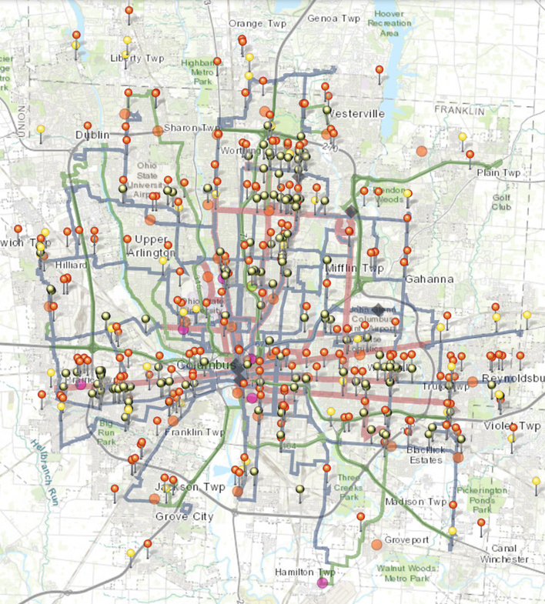






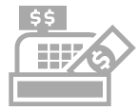

Retail Network
Customers will be able to easily digitize cash and add money to their COTA account at over 400 potential locations such as Speedway, Walgreens, Family Dollar, and more.
In-App / Web
In-Person
ACQUISITION
ENGAGEMENT
Customer generates barcode
(Digital)
Visits Participating Store
Presents account funding barcode to the cashier for scanning
Hands over cash or approved tender type
Cashier processes payment
Customer receives receipt
Account is credited immediately
New retail locations - 363% increase

Slide 10
Fare Changes
Under Consideration

Slide 11
Fare Changes under Consideration
No Fare Increase Being Considered
Proposed Changes
November 2021 (estimated) 2-Hour Passes Flat Fare Fare Capping Other changes being considered One Discount Fare Program Children Under 5 Ride at no cost
Future Changes Under Consideration
Low-Income Eligibility for Discount Fare Nonprofit Program Special Event Discontinue Cash Transfers and Onboard Day Passes

Slide 12



2-Hour Passes
Replace one-way transfers valid for 2 hours with 2-hour passes
A 2-Hour Pass provides customers unlimited access to COTA bus services within 2 hours.
Simplifies transfer policies
Easy to understand
Greater flexibility
Cost-effective
Potential revenue loss from customers who are able to complete a round-trip within 2 hours

Slide 13
Flat Fare
Eliminate Rush Hour fare upcharge
A Flat Fare structure charges the same amount regardless of the type of fixed route bus used.
Simplifies fare structure - making it easier to understand and implement
Limits complexity in fare capping
Benefits customers who transfer between services
Slight revenue loss

Slide 14

Fare Capping
Introduce daily and monthly fare capping, replacing 7-day and 31-day passes
Fare Capping enables a customer to pay towards a pass in increments, and fares are capped once a customer has paid the equivalent of a day or monthly pass.
A customer is guaranteed to never spend more than $62.00 in a month on fixed route services.
Example of Daily Fare Capping
COTA’s 2-hour pass costs $2.00 with a Day Pass priced at $4.50 and a Monthly Pass priced at $62.00
1st trip: $2.00 charged
2nd trip: $2.00 charged
3rd trip: $0.50 charged
Total fare collected for day: $4.50
Additional travel that day is at no additional cost
Once customer pays $62 in the month, additional travel that month is at no extra cost
Requires convenient access to load stored value frequently

Slide 15
Fare Capping
Introduce daily and monthly fare capping, replacing 7-day and 31-day passes
Improves affordability of passes
Provides customers with the “best fare”
Encourages transit use
Ease of use - pay as you go
Encourages electronic fare payment improving operations
Riders must have a smartphone or smart card and add funds to their accounts to benefit
Potential revenue loss
Complexity - takes time to explain the concept to customers
Eliminates 7-day and 31-day passes

Slide 16
Other Changes
One Discount Fare Program | Streamline application process and eliminate Senior/Key distinction
Simplification of “Child” Definition & Criteria | Replace 48” height limit with age limit (under 5 years of age) Eliminate limit of three children per adult

Slide 17
Next Steps
July
August
September
  Initial public feedback on fare changes under consideration
  Fare policy recommendation to Board for consideration
  Public comment process - online, by email, by phone, at public meeting
  Public hearing
  Title VI fare equity analysis report
  Board adoption of proposed fare changes

