Slide 1
welcome!
MOVING EVERY LIFE FORWARD
THIS MEETING WILL START SHORTLY
JUNE 9, 2022

Slide 2
MEETING PURPOSE
2
THANK YOU FOR JOINING US AND
participating.
MOVING EVERY LIFE FORWARD |
The purpose of this meeting is to take public comment on the Income Assistance pilot program and the proposed service changes that will take effect on September 5, 2022
No final decisions have been made for the September 2022 service change.

Slide 3
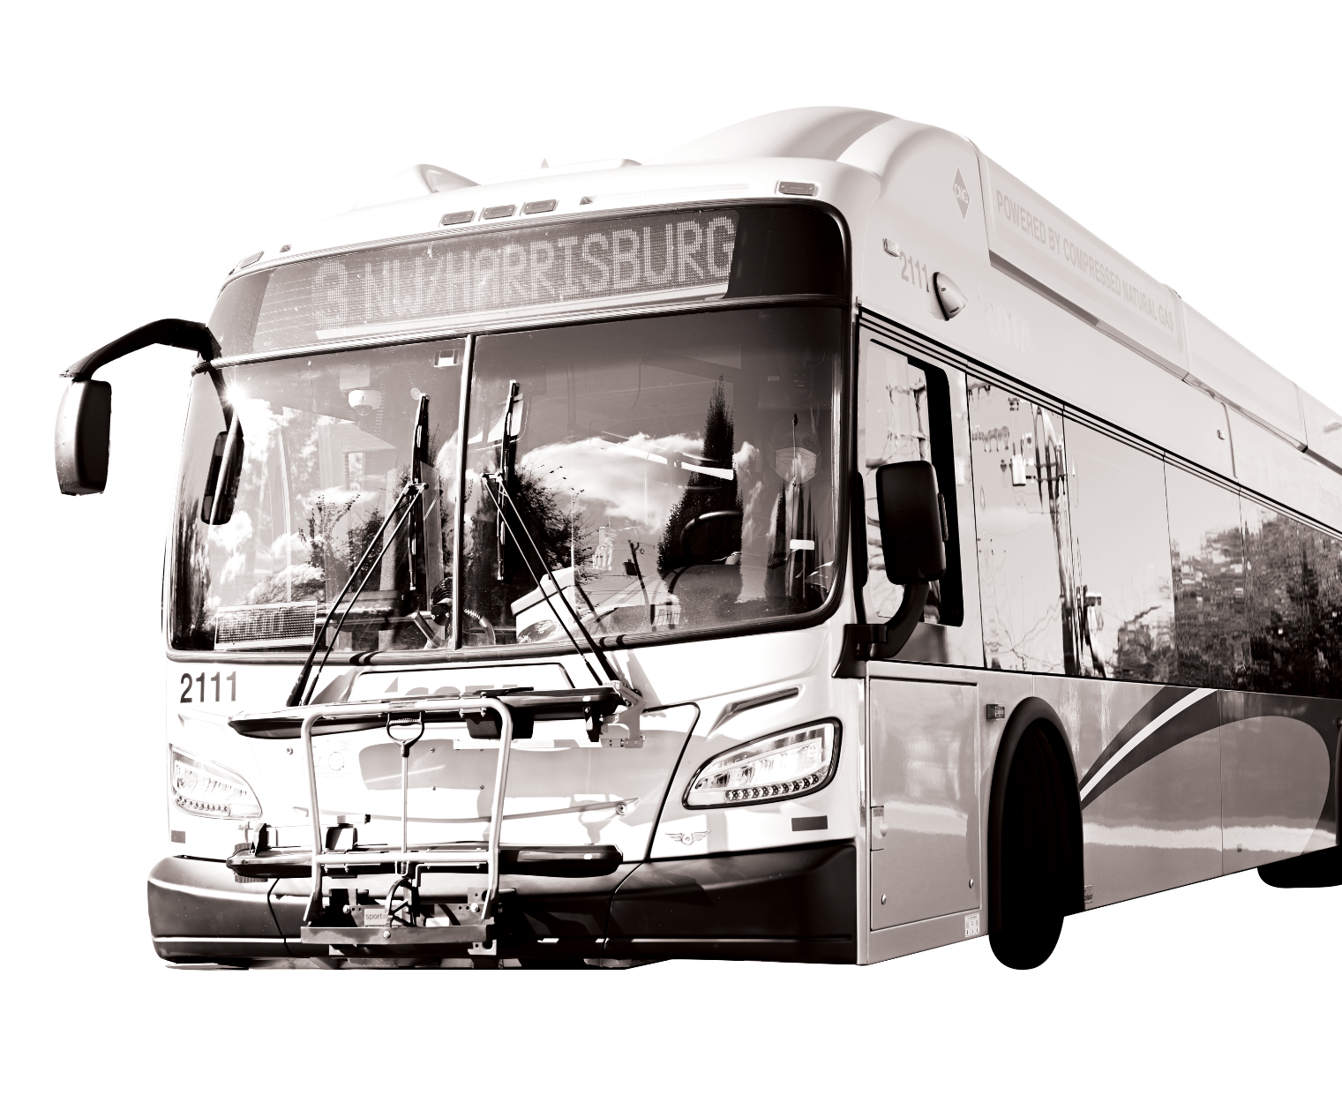
Meeting Format
We are recording this meeting. The recording will be posted on our website at COTA.com. If you are joining us by computer or phone, please know we cannot see or hear you. Please be considerate of meeting attendees and COTA staff.
MOVING EVERY LIFE FORWARD |
HOW TO COMMUNICATE WITH COTA
If joining by computer, submit comments and questions via the Q&A Chat Box. If joining by phone, please direct all question or comments to COTA’s Customer Care Center at (614) 228-1776. If joining by Facebook Live, please submit your question by commenting in the livestream.

Slide 4
How to Use Q&A Chat
MOVING EVERY LIFE FORWARD |
\+
032\+

Slide 5
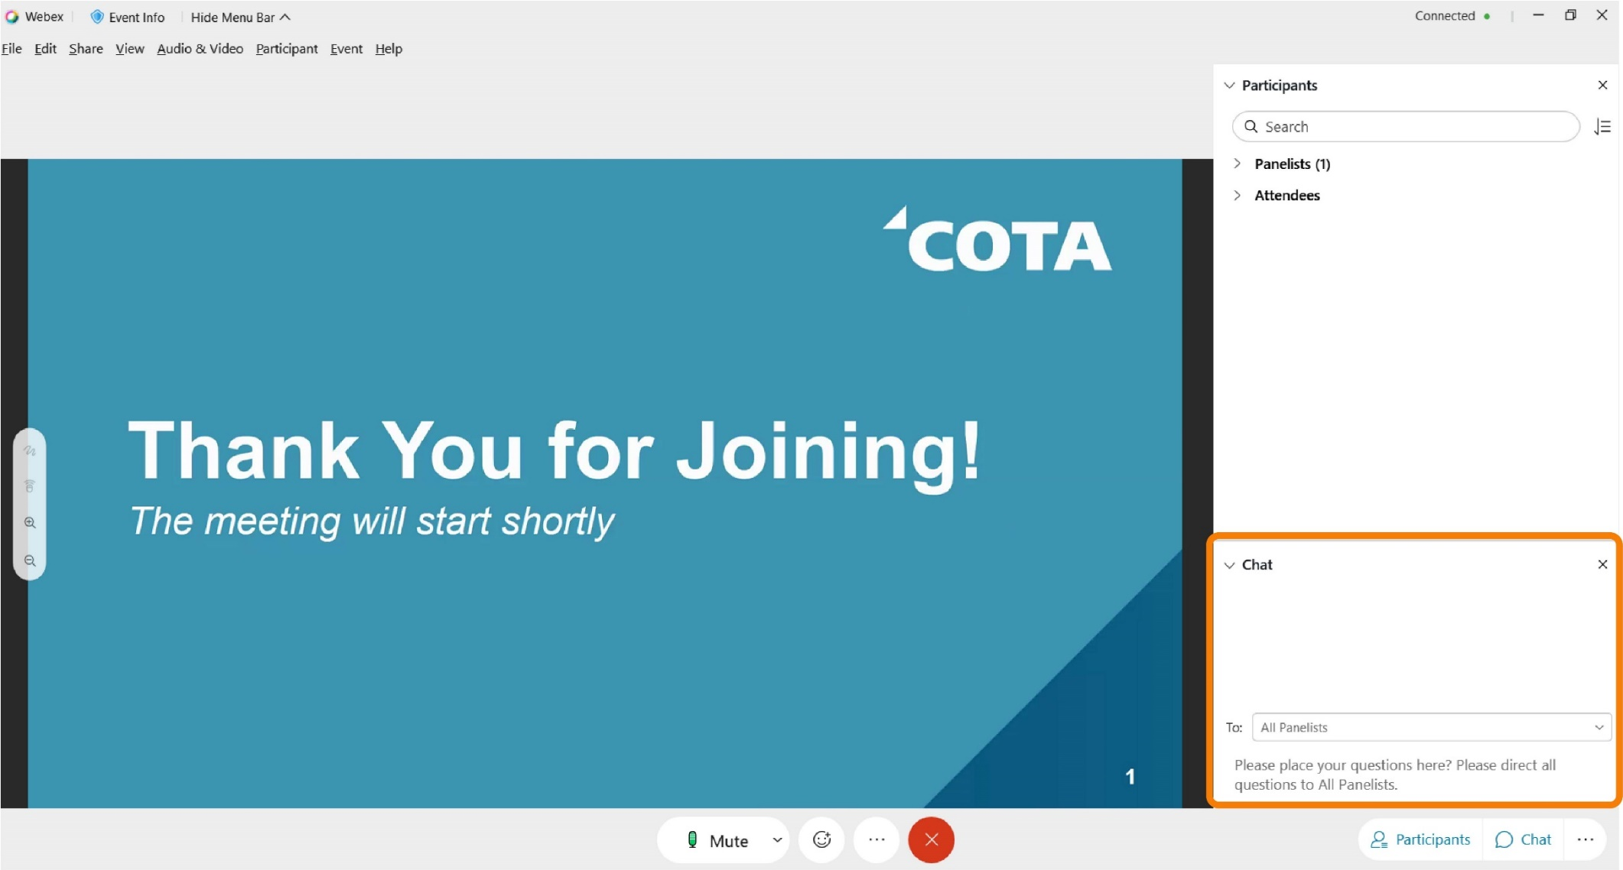
How to Use Q&A Chat
MOVING EVERY LIFE FORWARD |

Slide 6
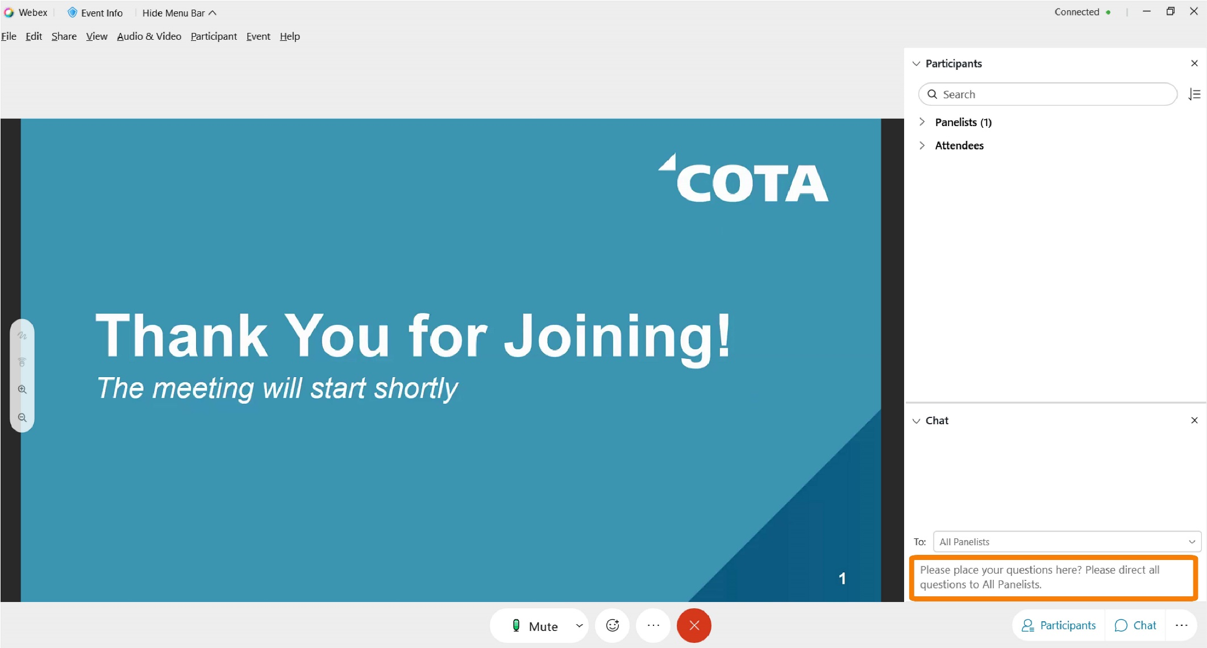
How to Use Q&A Chat
MOVING EVERY LIFE FORWARD |

Slide 7
7
Income Assistance
PILOT PROGRAM
MOVING EVERY LIFE FORWARD |

Slide 8
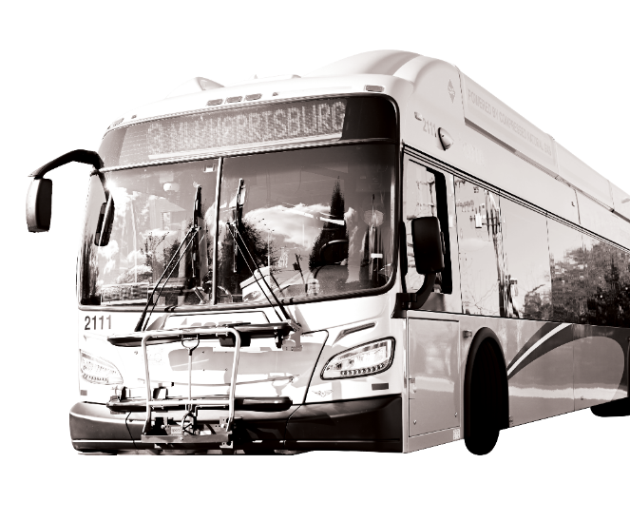
Public Comment on Fare Changes
NO
Fare increases
UNDER CONSIDERATION
MOVING EVERY LIFE FORWARD |

Slide 9
Income Assistance Pilot Program
COTA’s Board of Trustees approved a six-month pilot that extends eligibility for 50% transit discounts to individuals who receive public income assistance.
MOVING EVERY LIFE FORWARD |
Pilot Period: March 1- August 31
Proof of Participation Accepted
SNAP
Publicly funded childcare
Ohio Works First cash assistance
Prevention, Retention and Contingency emergency assistance
Medicaid
Temporary Assistance to Needy Families
Eligibility: One Year

Slide 10
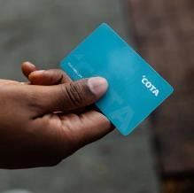
How to Apply
Customers can apply for the discount program at the COTA Customer Experience Center (33 N. High St.). Hours of operation are 8 a.m. to 5 p.m. Monday-Friday.
MOVING EVERY LIFE FORWARD |
Customers who qualify for COTA’s Income Assistance Program will need to use one of our payment methods included in COTA’s new digital fare payment system to receive the discount.
You can set up an account through the Transit app or obtain a COTA Smartcard at the Customer Experience Center.

Slide 11
Important Dates to Remember
Next meeting
Final approval
MOVING EVERY LIFE FORWARD |
Tuesday, June 14 at noon
Attend and participate in the public meetings by joining:
In Person
Virtually
Phone
COTA Board of Trustees Meeting
Wednesday, July 27 at 9 a.m.

Slide 12
Q&A Chat
Have a question about the Income Assistance Pilot Program?​
If joining via WebEx, submit comments via the chat box. ​
If joining via phone, please wait to unmute yourself until directed by the moderator. ​
If joining via Facebook Live, please comment your questions​ in the livestream. ​
Visit cota.com/contact to learn more about this program.

Slide 13
up next:
Proposed Service Changes

Slide 14
COVID-19 Policy Updates
MOVING EVERY LIFE FORWARD |
How is COTA keeping customers and employees safe? COTA will continue to provide the following measures to keep customers and employees safe:
Cleaning and sanitization on all transit vehicles and at high-ridership stops
Installed operator barriers on fixed-route fleet
Proper ventilation
Hand sanitizer
Mask policy was lifted on April 19

Slide 15
Workforce Challenges
Like most organizations, COTA is impacted by the nationwide worker shortage. COTA continues to recruit and hire new transit operators, but those new hires are not enough to offset retirements and other departures.
COTA will continue to adjust transit schedules due to unprecedented workforce challenges.
The adjustments will be made to improve service reliability and help minimize adverse service impacts to our customers and staff.
MOVING EVERY LIFE FORWARD |

Slide 16
COTA is HIRING!
COTA is actively recruiting, hiring and training new operators. Anyone interested in a rewarding career at COTA can learn more and apply at COTA.com/careers.
COTA's starting wage for operators in training has been increased to $17.50/hour.
Upon completion of training, operators' wage increases to $21.10/hour.
Operators can make more than $33/hour in 5 years
COTA is in the top 5% among peer agencies for wage & benefits
MOVING EVERY LIFE FORWARD |
SERVICE REQUESTS
COTA will continue to document requests for service and work to restore service hours.

Slide 17
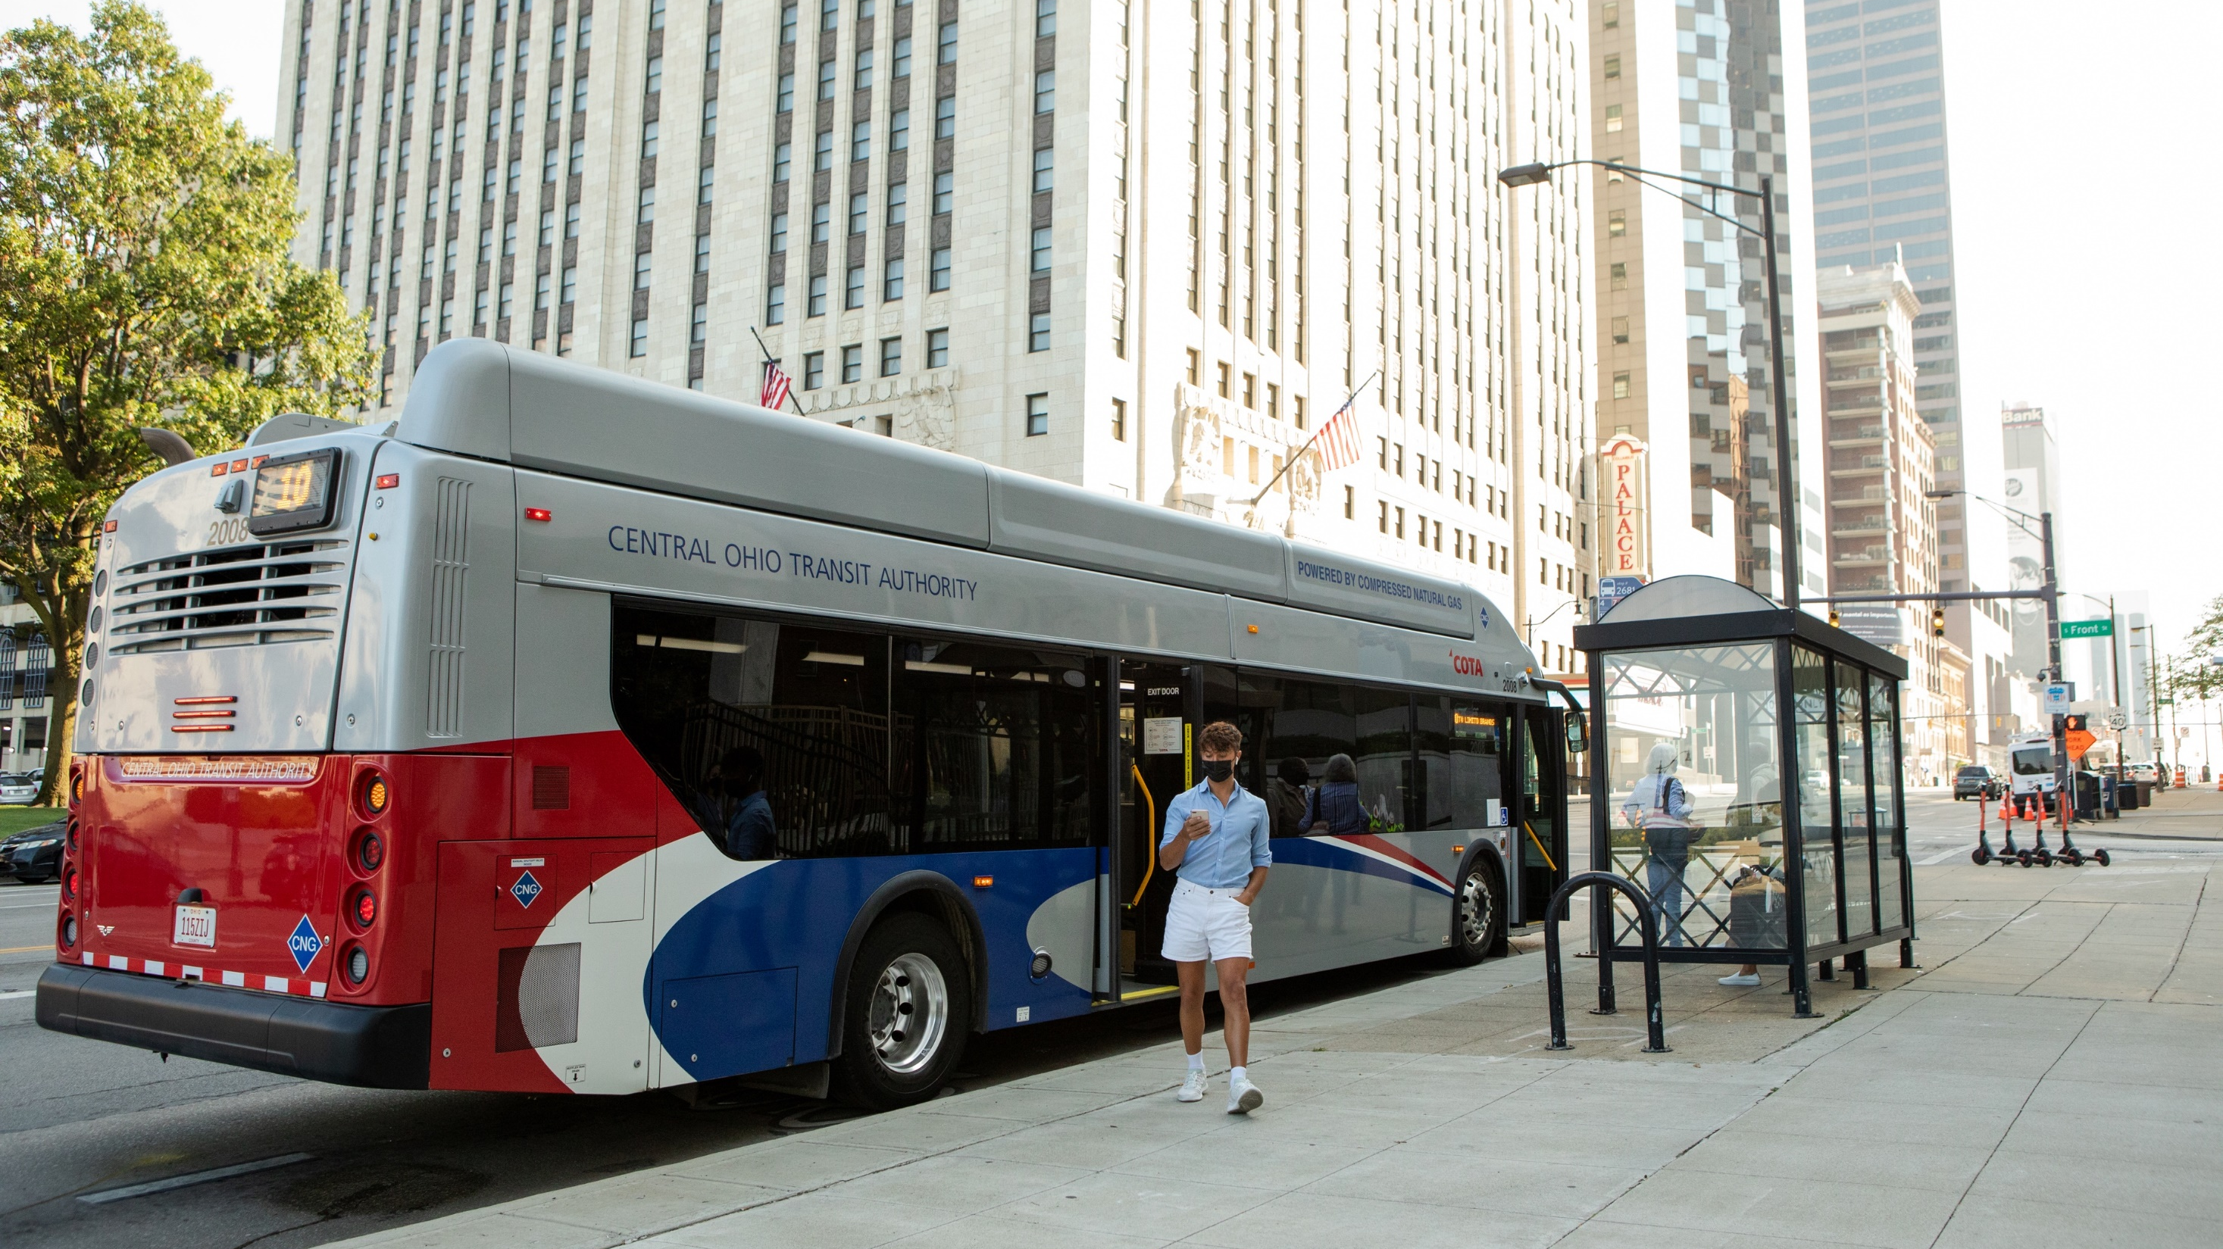
17
service
CHANGES
MOVING EVERY LIFE FORWARD |
The following service adjustments are proposed to begin on Monday, September 5, 2022.
No final decisions have been made for the September 2022 service change.

Slide 18
Summary of Changes
LINES | LINE NAME | CHANGES
1 | Kenny / Livingston | Frequency reduction
2 | N High / E Main | Frequency reduction
3 | Northwest / Harrisburg | Frequency reduction
4 | Indianola / Lockbourne | Frequency reduction and route change
6 | Cleveland / Sullivant | Route change
8 | Karl / S High / Parsons | Frequency reduction
10 | E Broad / W Broad | Frequency reduction
11 | Bryden / Maize | Frequency reduction and route change
22 | OSU-Rickenbacker | Frequency reduction
23 | James-Stelzer | Frequency reduction
LINES | LINE NAME | CHANGES
24 | Hamilton | Route name change
31 | Hudson | Frequency reduction
34 | Morse | Frequency reduction
102 | Polaris Pkwy / N High | Frequency reduction
CMAX |  | Frequency reduction
Zoo Bus |  | Seasonal service will end on October 31
AirConnect |  | Partial service will end on August 30
All Rush Hour Lines 41, 42, 43, 44, 45, 46, 51, 52, 61, 71, 72, 73, 74, 75 |  | No change
MOVING EVERY LIFE FORWARD |
Disclaimer: Lines may be added or removed as on-time performance information becomes available.

Slide 19
Frequency Reductions – frequent
LINES | LINE NAME | CURRENT FREQUENCY | PROPOSED CHANGES
1 | Kenny / Livingston | 15 minutes between Reynoldsburg and Riverside Hospital & 30 minutes between Riverside Hospital and Carriage Place seven days a week | 20 minutes between Reynoldsburg and Riverside Hospital & 40 minutes between Riverside Hospital and Carriage Place on Sundays only
2 | E Main / N High | 15 minutes between Westview Turnaround and Great Eastern & 30 minutes between Great Eastern and Main & Hanson seven days a week | 20 minutes between Westview Turnaround and Great Eastern & 40 minutes between Great Eastern and Main & Hanson on Sundays only
8 | Karl / S High / Parsons | 15 minutes between Boardwalk & Shapter and downtown & 30 minutes south of downtown seven days a week | 20 minutes between Boardwalk & Shapter and downtown & 40 minutes south of downtown on Sundays only
10 | E Broad / W Broad | 15 minutes between Westwoods and Mt Carmel East Hospital & 30 minutes between Mt Carmel and Limited Brands seven days a week | 20 minutes between Westwoods and Mt Carmel East Hospital & 40 minutes between Mt Carmel and Limited Brands on Sundays only
CMAX |  | 15 minutes between downtown and Northland Transit Center & 30 minutes between Northland and Westerville seven days a week | 20 minutes between downtown and Northland Transit Center & 40 minutes between Northland and Westerville on Sundays only
All Frequent Lines (1,2,8,10,CMAX) |  | Varies by line | All lines will run every 30 minutes before 7am
Disclaimer: All changes are proposed. No final decisions have been made for the September 2022 Service Change.
Notes:
Methodology -Recommendations were made after reviewing trips on each line….removing singular trip will not have enough impact on reducing the amount operators needed

Slide 20
Frequency Reductions – standard
LINES | LINE NAME | CURRENT FREQUENCY | PROPOSED CHANGES
3 | Northwest / Harrisburg | 30 minutes Monday through Friday & 60 minutes on Saturday and Sunday | 45 minutes Monday through Friday & 60 minutes on Saturday and Sunday
4 | Indianola / Lockbourne | 30 minutes seven days a week | 60 minutes seven days a week
6 | Cleveland / Sullivant | 60 minutes on Cleveland Ave & 30 minutes west of Downtown seven days a week | Discontinue service on Cleveland Ave & 30 minutes west of Downtown seven days a week
22 | OSU-Rickenbacker | 15 minutes south of Broad Street and 30 minutes remainder Monday through Friday & 30 minutes Saturday and Sunday | 15 minutes south of Broad Street and 30 minutes remainder Monday through Friday & 40 minutes Saturday and Sunday
23 | James-Stelzer | 30 minutes Monday through Friday & 60 minutes on Saturday and Sunday | 60 minutes seven days a week
31 | Hudson | 30 minutes seven days a week | 60 minutes seven days a week
34 | Morse | 30 minutes Monday through Friday & 60 minutes on Saturday and Sunday | 60 minutes seven days a week
102 | N High / Polaris Pkwy | 30 minutes seven days a week | 60 minutes seven days a week
Disclaimer: Lines may be added or removed as on-time performance information becomes available.
All changes are proposed. No final decisions have been made for the September 2022 Service Change.

Slide 21
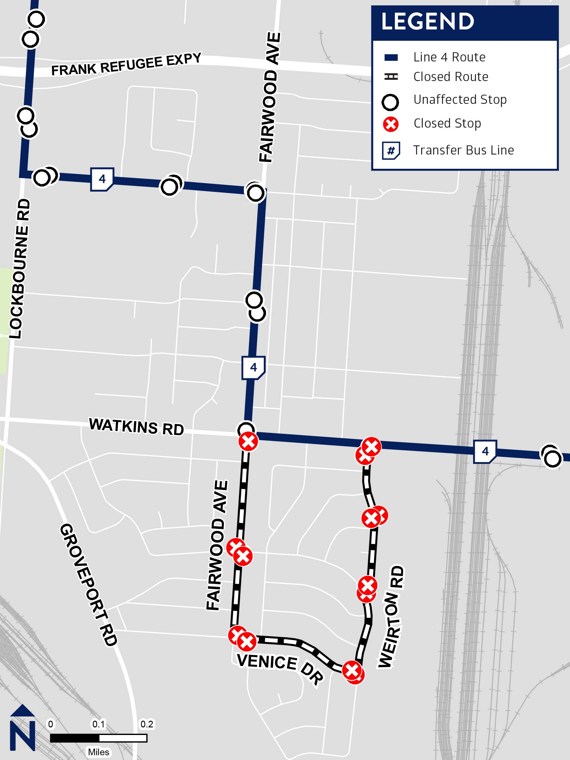
Line 4 Routing Change
In order to provide a simple, more direct route to and from Alum Creek Drive. COTA is proposing to remove Line 4 Indianola/Lockbourne along Venice Dr and Weirton Rd .
Line 4 would remain on Watkins Rd in both directions. Stops along Venice Dr and Weirton Rd would permanently close.
Customers impacted by this change are encouraged to use COTA//Plus South Side zone. COTA//Plus South Side operates from 5:30am to 8:00pm seven days a week. Customers can request a ride using the COTA//Plus mobile app.
MOVING EVERY LIFE FORWARD |
Notes:
Customers impacted by this change are encouraged to use COTA//Plus South Side zone.

Slide 22
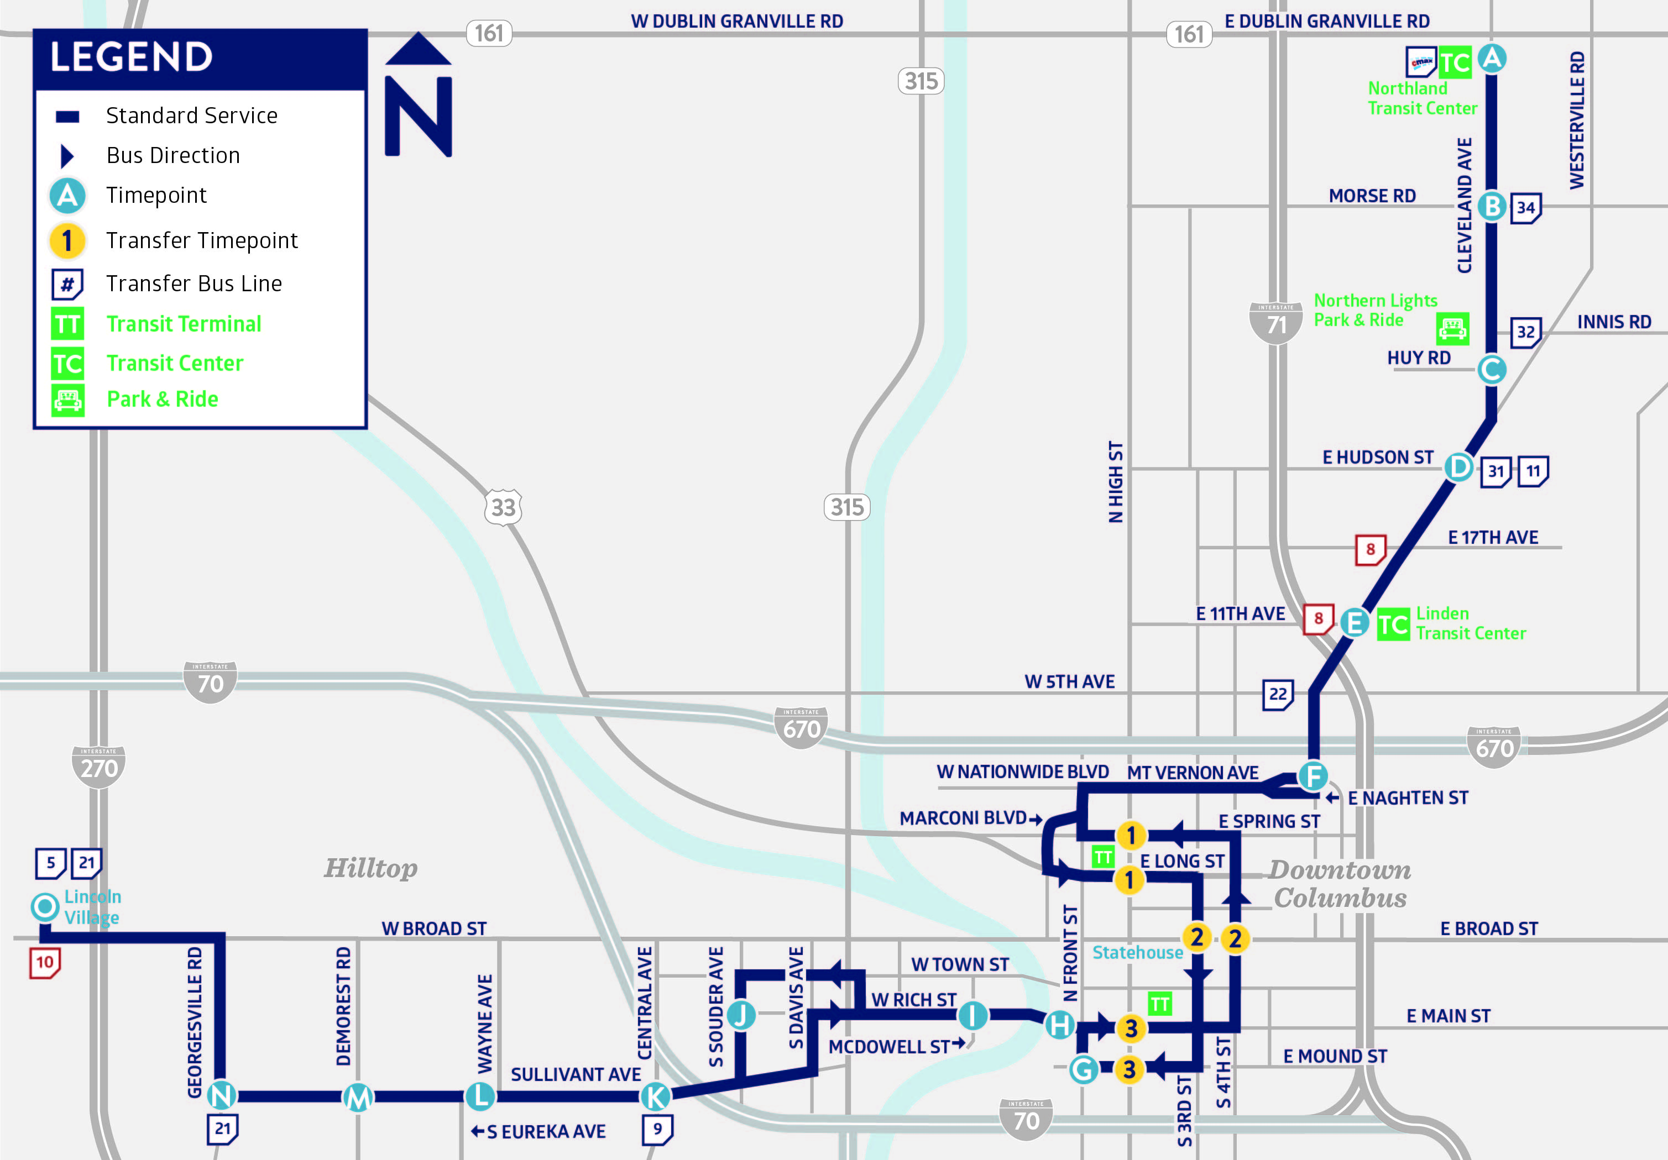
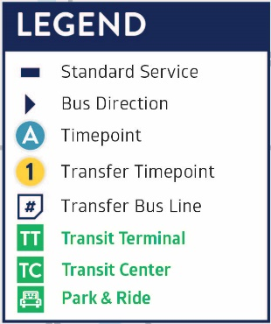
Line 6 Routing Change
COTA is proposing Line 6 Cleveland/Sullivant no longer operate along Cleveland Ave. Instead, Line 6 would operate every 30 minutes from downtown Columbus to Lincoln Village.
Customers traveling north of downtown Columbus are encouraged to use COTA's CMAX.
CMAX, COTA's rapid transit line, operates every 15 minutes between downtown Columbus and Northland Transit Center. This line features traffic signal priority and LCD real-time, next bus arrival information screens. After 7:00pm, CMAX would serve all existing Line 6 stops.
MOVING EVERY LIFE FORWARD |

Slide 23
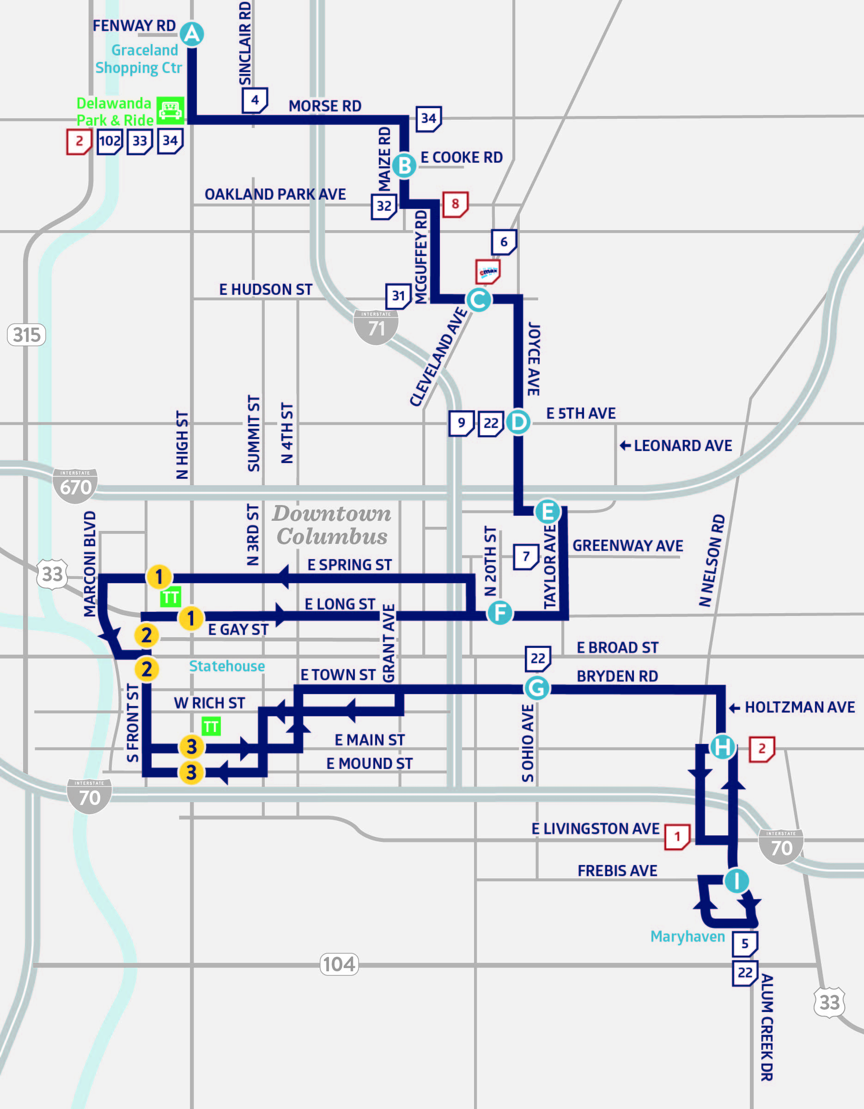
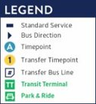
Line 11 Routing Change
COTA is proposing to discontinue Line 11 Bryden/Maize south of downtown Columbus. Instead, Line 11 would operate between the COTA's Westview Turnaround and downtown Columbus, every 60 minutes.
Customers traveling west of downtown Columbus are encouraged to use Line 2 E Main/N High. Line 2 operates every 15 minutes between downtown Columbus and the Kroger near the intersection of Holtzman Ave & E Main St.
Customers traveling south of Downtown are encouraged to use Line 1 Kenny/Livingston to transfer into COTA//Plus South Side Zone. Line 1 operates every 15 minutes between downtown Columbus and the South Side Zone. COTA//Plus South Side operates from 5:30am to 8:00pm seven days a week. Customers can request a ride using the COTA//Plus mobile app.
MOVING EVERY LIFE FORWARD |
Notes:
Less than a .25-mile walk between Line 2 stops on Main and Line 11 stops on Bryden (.25 mile walk = 4 minutes). Passengers with mobility limitations are encouraged to consider COTA's Mainstream & Mainstream On-Demand service.

Slide 24
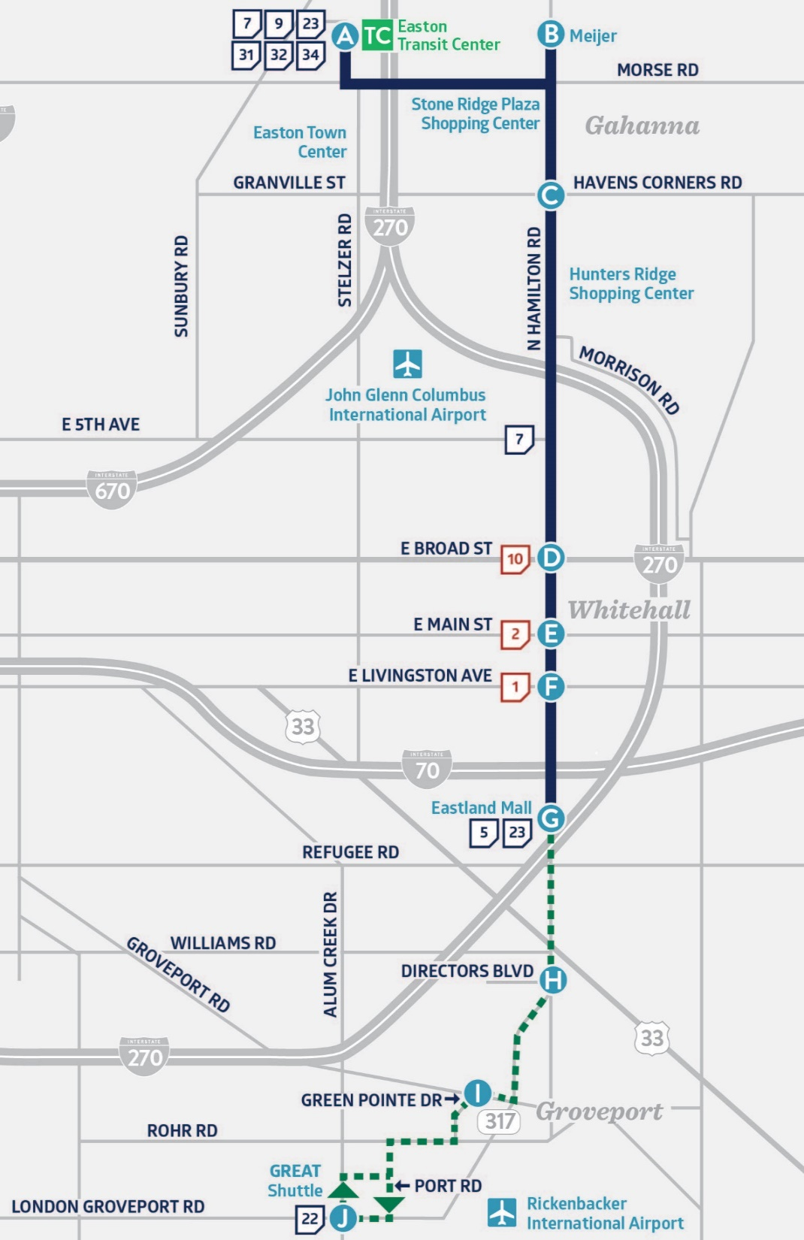
Line 24 Hamilton Name Change
COTA is proposing to rename Line 24 operating south of Eastland Mall!
Currently Line 24 operates hourly between Easton Transit Center and Eastland Mall.
Between Eastland Mall & Rickenbacker, Line 24 operates as a weekday only circulator. Line 24 passengers traveling south of Eastland Mall must transfer to a Line 24 vehicle with a destination header displaying “Rickenbacker”.
This service run hourly service from 6am to 9pm. No changes will be made to alignment or frequency.
MOVING EVERY LIFE FORWARD |

Slide 25
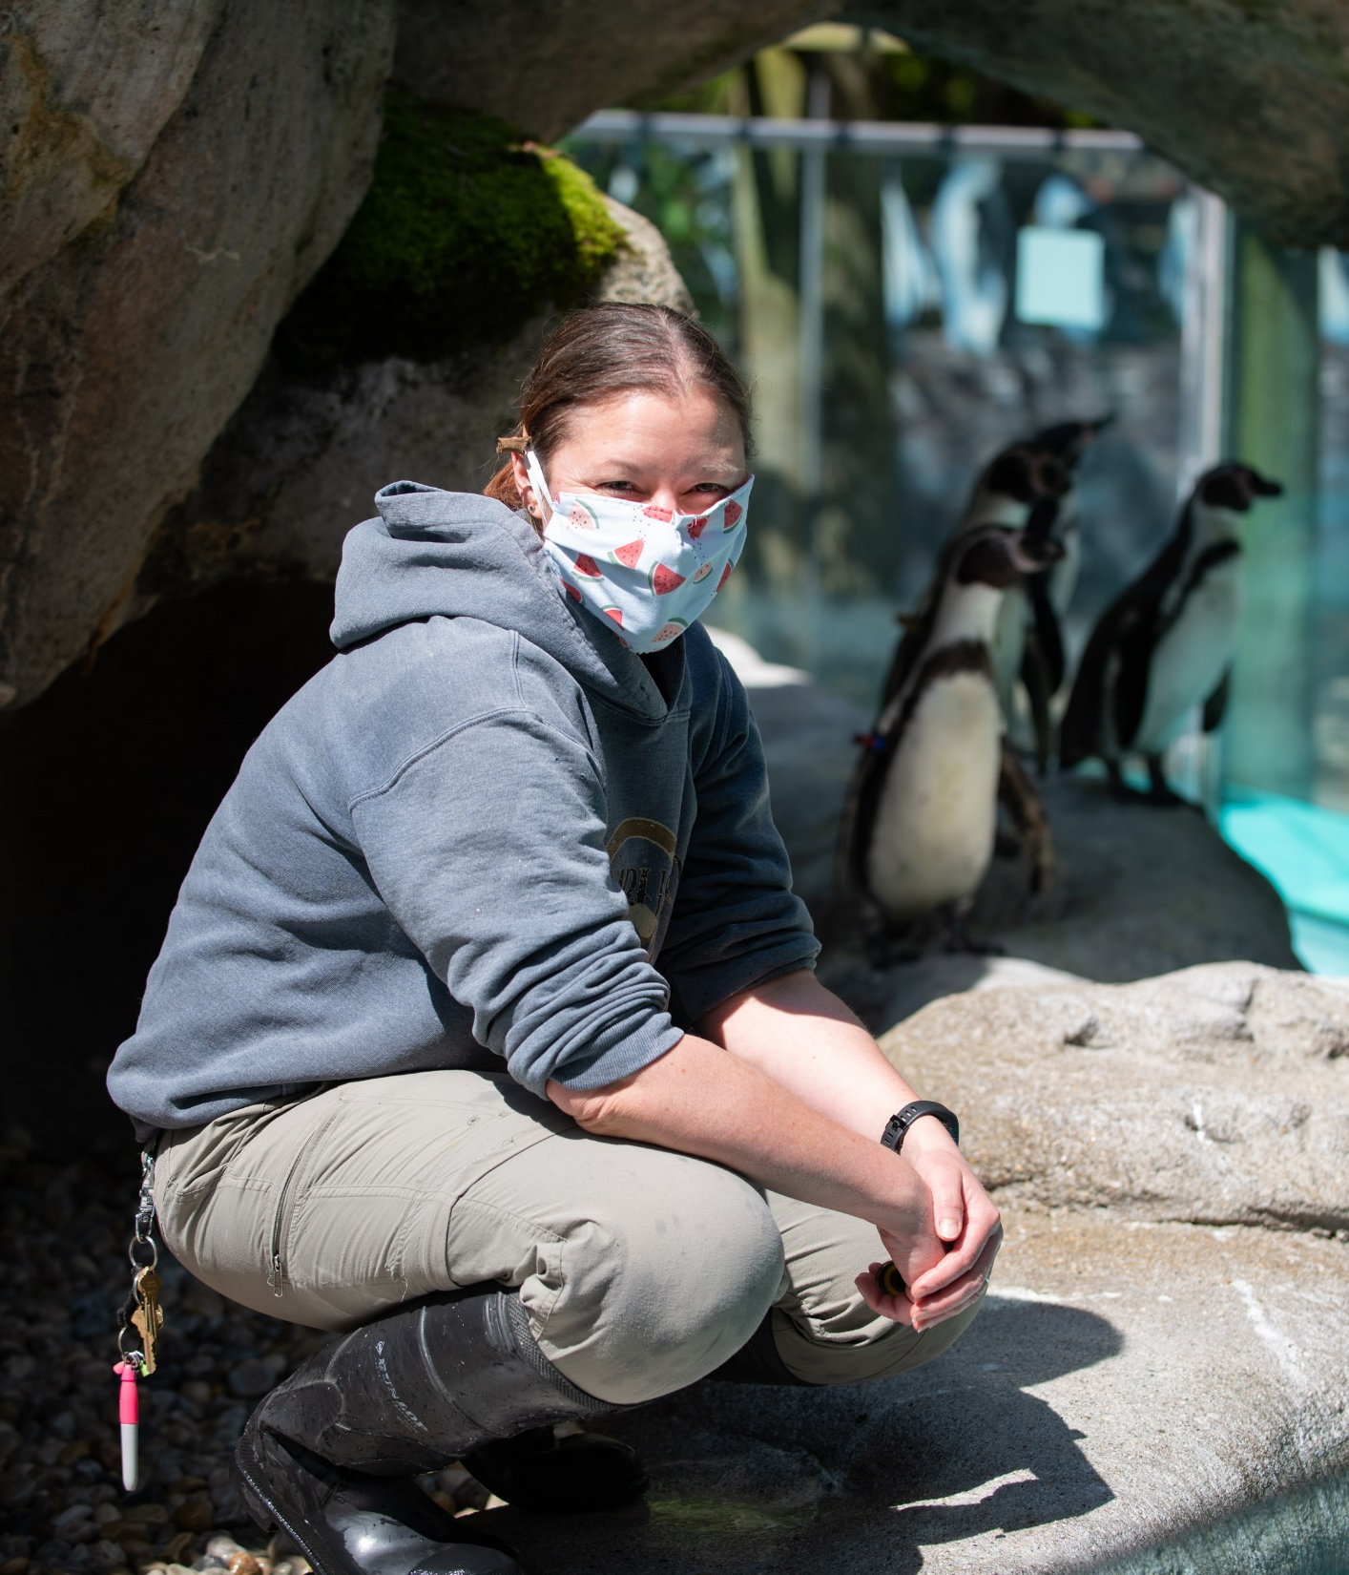
Zoo Bus Service
Zoo Bus service will end on Halloween!
Zoo service began Saturday, May 7 and will continue to operate on weekends until Memorial Day. Beginning Memorial Day, Monday, May 30 and running through Labor Day, Monday, Sept. 5, the Zoo Bus will operate 7 days a week. Beginning Friday, Sept 9 Zoo Bus will return to Friday, Saturday, and Sunday only service until Halloween, Oct 31
The Zoo Bus operates according to the holiday/ Sunday schedule on Memorial Day, Independence Day and Labor Day. For more information about COTA Zoo Bus service, visit COTA.com/ZooBus or call (614) 228-1776. For Zoo and Zoombezi Bay hours, visit columbuszoo.org.
MOVING EVERY LIFE FORWARD |

Slide 26
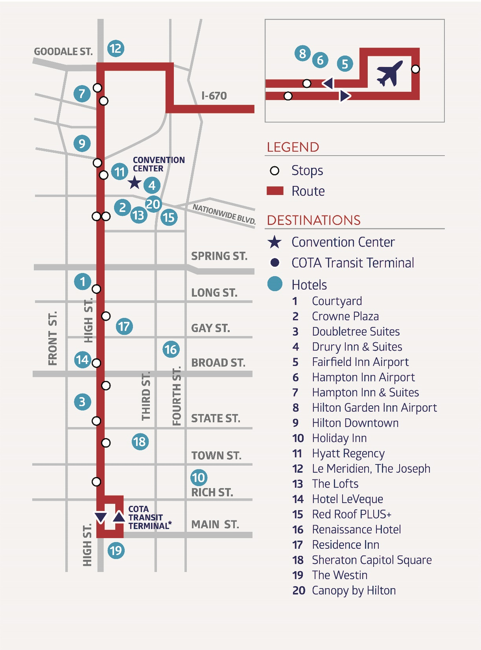
AirConnect Service for Events
MOVING EVERY LIFE FORWARD |
Select AirConnect event service will end on August 30!
AirConnect began operating on April 30 during select events to address anticipated ridership demand. Operating between John Glenn International Airport and downtown Columbus, this service will end in August.
Service operates from 6 a.m. to 9:30 p.m., with trips every 30 minutes during select events only. Visit cota.com/airconnect to learn more.
Sonesta

Slide 27
AirConnect Service for Events
EVENTS | DATES OF SERVICE
APTA Mobility Conference | April 30 – May 5
US Chess Elementary Championship | May 12 – May 16
Plexus Worldwide – 2022 Ignite Convention | June 21 – June 25
Church of God in Christ, Inc. – 2022 Auxiliaries Ministry Convention | July 3 – July 10
AmericanHort Cultivate ‘22 | July 15 –July 20
Thirty-one Gifts | July 20 –July 25
Fraternal Order of Eagles – 2022 International Convention | July 29– August 5
Americas Print Show 2022 | August 16 –August 20
National Guard Association General Conference & Exhibition | August 25 –August 30
MOVING EVERY LIFE FORWARD |

Slide 28
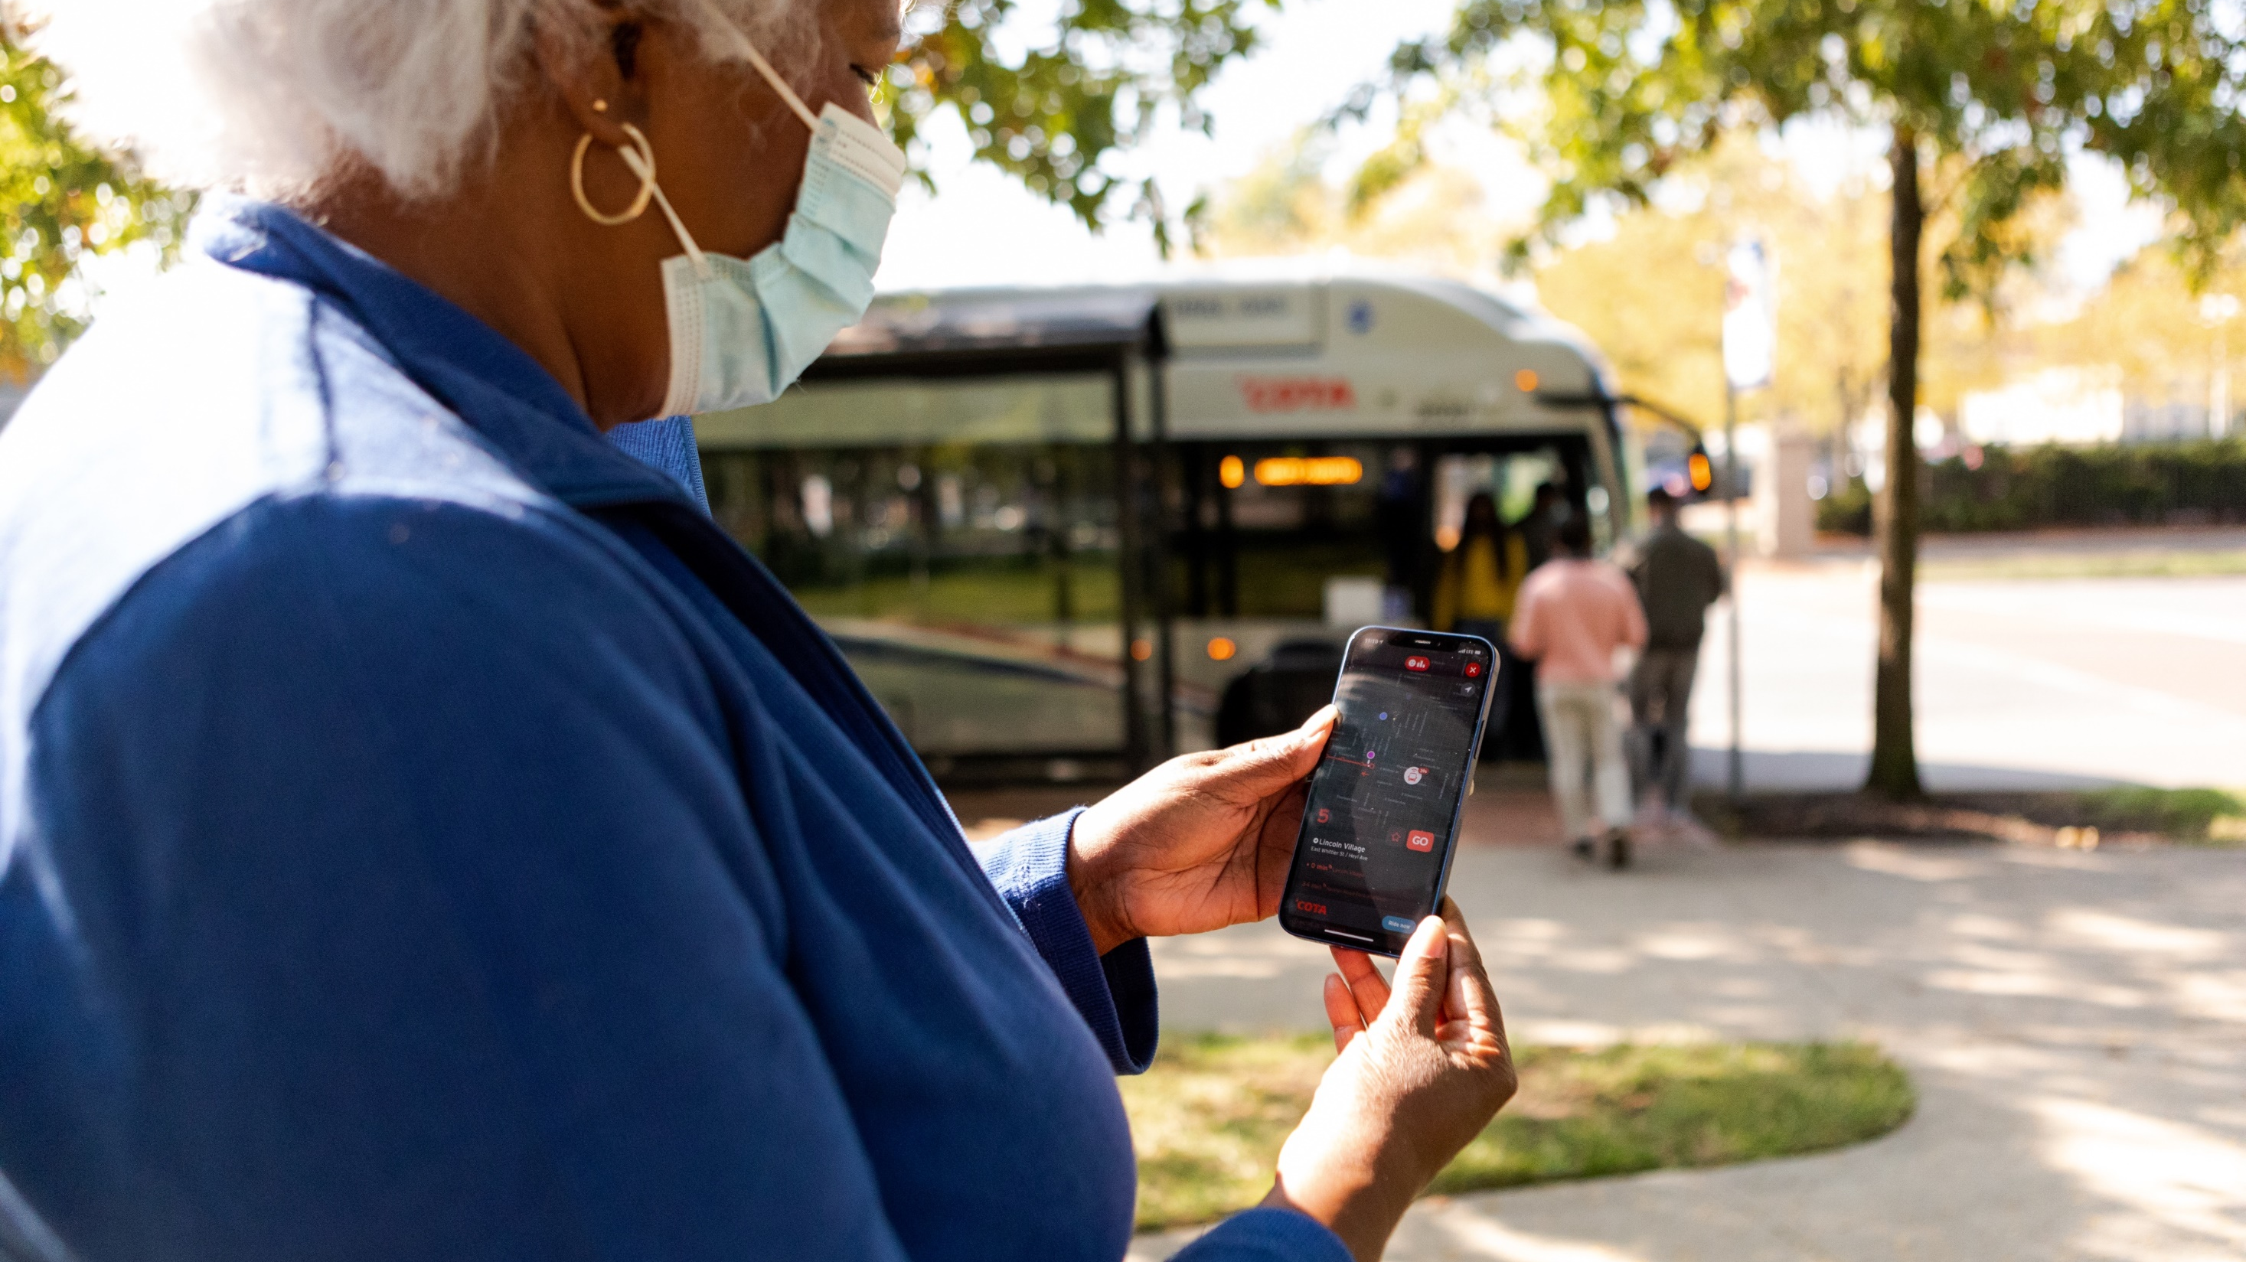
28
MOVING EVERY LIFE FORWARD |
new & upcoming
PROGRAMS AND EVENTS

Slide 29
Summer Student Pass Program
Introducing our new Summer Student Pass Program! This is an easy and affordable summer pass program for Central Ohio K-12 schools and local universities that gives eligible students ages 5 and older unlimited access to COTA.
$62/student per term
Unlimited Rides through September 15
Includes COTA//Plus & Mainstream (if eligible)
Learn more at COTA.com/ssp
Notes:
Only talk about if asked..

Slide 30
Q&A Chat
Have a question about the proposed service changes?
If joining via WebEx, submit comments via the chat box.
If joining via phone, please wait to unmute yourself until directed by the moderator.
If joining via Facebook Live, please comment your questions in the livestream.
Visit cota.com/contact to suggest how we can improve COTA’s service.
Final service changes will be announced at the August Public Meetings!
Thursday, August 18 at 6pm
Tuesday, August 23 at noon

Slide 31
MOVING EVERY LIFE FORWARD
COTA.COM

Slide 32
COTA’s new Way to Pay
In November 2021, COTA launched our partnership with the Transit app. This mobile app offers a revolutionary new way to plan, track and pay for COTA rides, making our mobility solutions more affordable, accessible and safe.
MOVING EVERY LIFE FORWARD |
BENEFITS
Fare capping $4.50/day and $62/month
Simplified two-hour fares
Network of up to 350 retailers where customers can load funds to their COTA accounts
COTA Smartcards available for those without smartphones

Slide 33
Income Assistance Pilot Program
MOVING EVERY LIFE FORWARD |
COTA’s Board of Trustees approved a 6-month pilot program that extends eligibility for transit discounts to individuals who receive public income assistance.
Launched March 1
Proof of participation accepted
SNAP
Publicly funded childcare
Ohio Works First cash assistance
Prevention, Retention and Contingency emergency assistance
Medicaid
Temporary Assistance to Needy Families
Notes:
March 1 – September 1

Slide 34
Transit Amenity Contribution Program
COTA launched a new program that invites customers to be a part of improving the mobility experience. Through the new program, customers can:
MOVING EVERY LIFE FORWARD |
Request an Amenity Customers can request replacements and repairs for amenities including trash cans, benches, shelters and lights at a transit stop.
Contribute Toward a New Amenity You can help improve the mobility experience in your neighborhood by contributing toward a new amenity.
Adopt-A-Stop When you or your organization signs up to Adopt-a-Stop, you agree to help pick up litter and empty the COTA-provided trash receptacles at the adopted location.

