Slide 1
welcome!
MOVING EVERY LIFE FORWARD
THIS MEETING WILL START SHORTLY
SEPTEMBER 15, 2022

Slide 2
MEETING PURPOSE
2
THANK YOU FOR JOINING US AND
participating.
MOVING EVERY LIFE FORWARD |

Slide 3
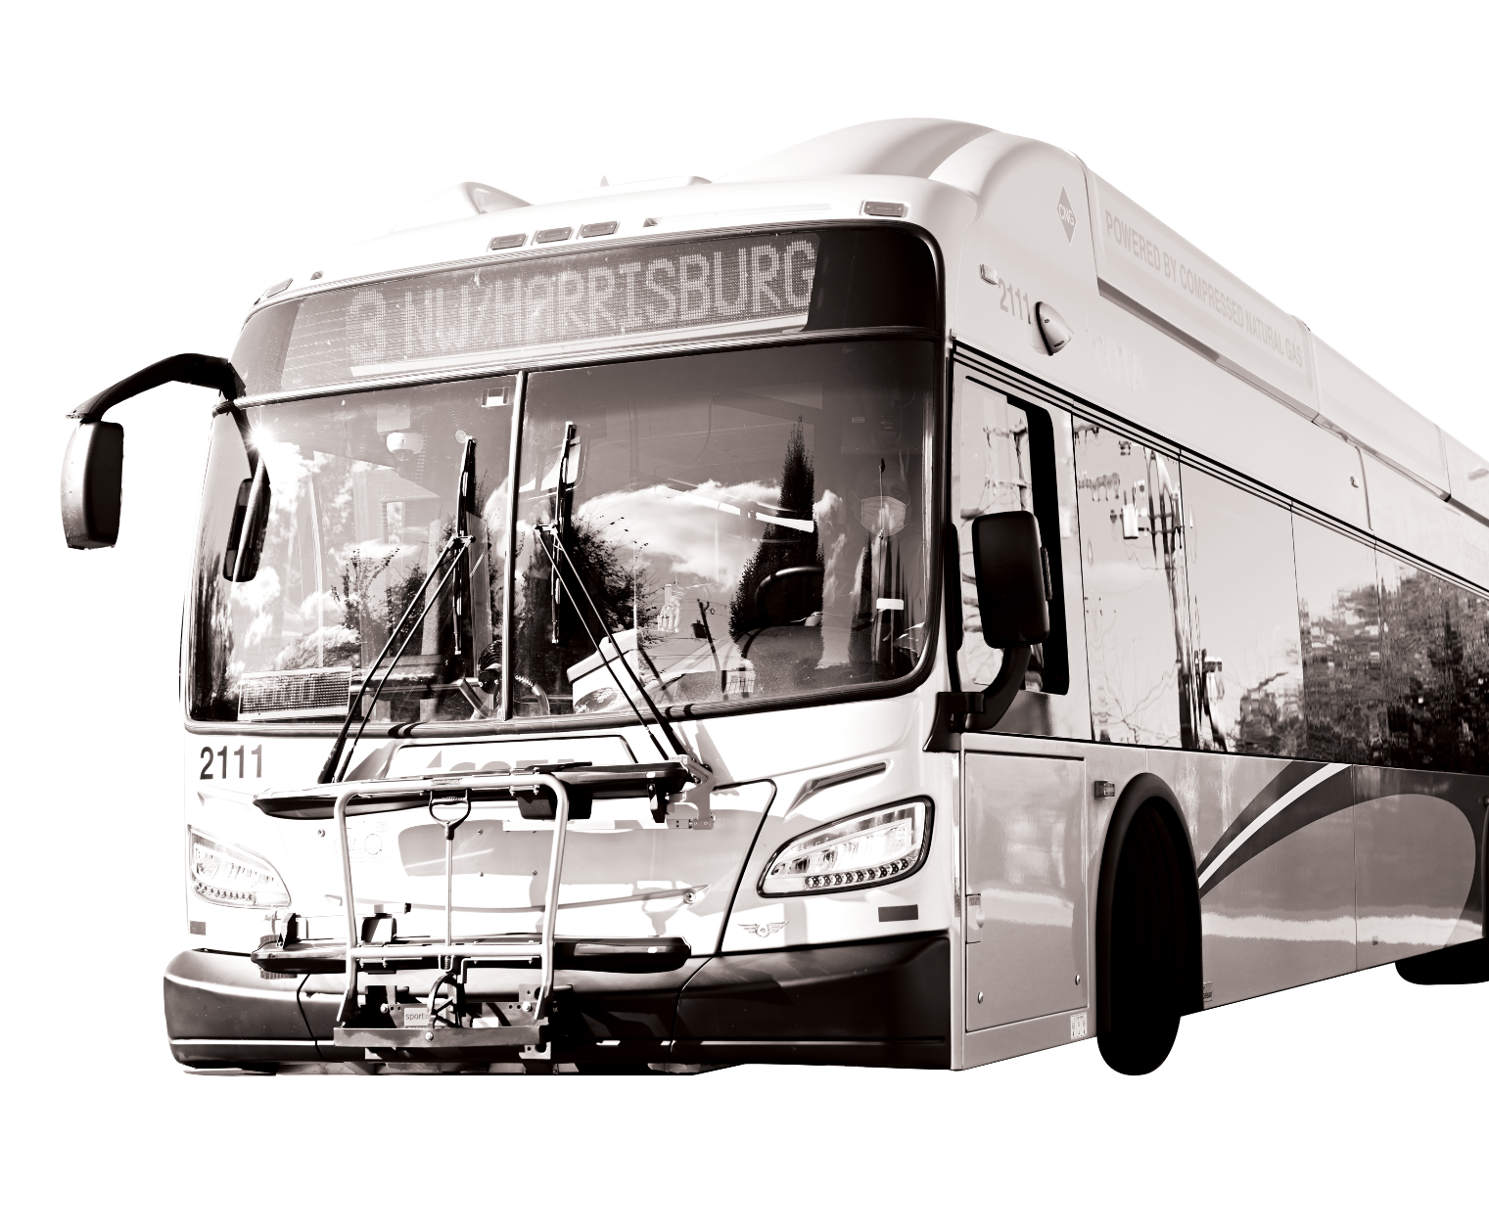
Meeting Format
We are recording this meeting. The recording will be posted on our website at COTA.com. If you are joining us by computer or phone, please know we cannot see or hear you. Please be considerate of meeting attendees and COTA staff.
MOVING EVERY LIFE FORWARD |
HOW TO COMMUNICATE WITH COTA
If joining by computer, submit comments and questions via the Q&A Chat Box. If joining by phone, please direct all question or comments to COTA’s Customer Care Center at (614) 228-1776. If joining by Facebook Live, please submit your question by commenting in the livestream.

Slide 4
How to Use Q&A Chat
MOVING EVERY LIFE FORWARD |
\+
032\+

Slide 5
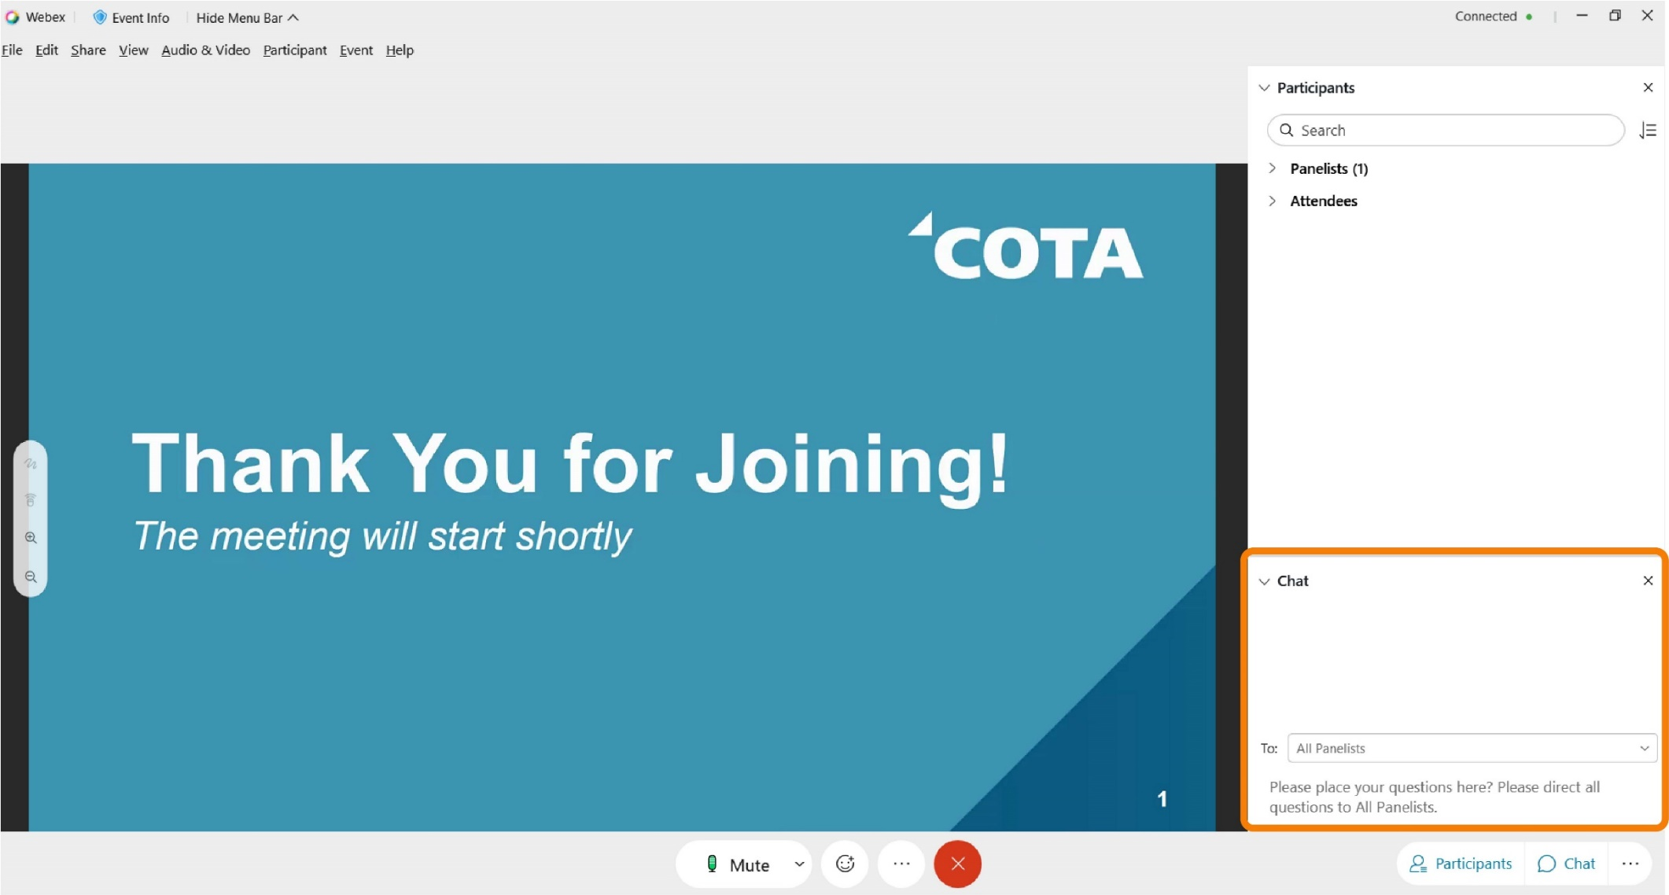
How to Use Q&A Chat
MOVING EVERY LIFE FORWARD |

Slide 6
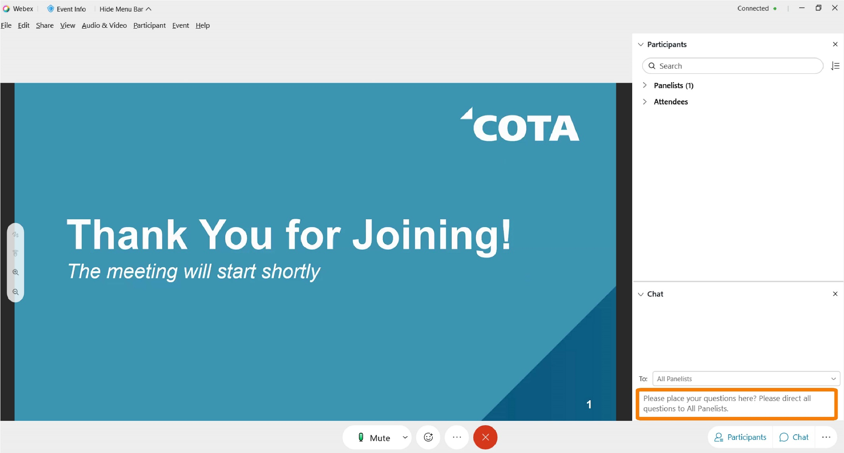
How to Use Q&A Chat
MOVING EVERY LIFE FORWARD |

Slide 7
Workforce Challenges & Reduced Service
Like most organizations, COTA is impacted by the nationwide worker shortage. COTA continues to recruit and hire new transit operators, but those new hires are not enough to offset retirements and other departures.
COTA will continue to adjust transit schedules due to unprecedented workforce challenges. The adjustments will be made to improve service reliability and help minimize adverse service impacts to our customers and staff.
We hope to begin adding service in future trimesters when we are able to hire, train and retain more operators.
MOVING EVERY LIFE FORWARD |

Slide 8
Recruitment
Transit agencies across the nation are facing a shortage of operators, which have resulted in reduced services. COTA has embarked on a robust Moving Forward recruitment campaign to address workforce reductions throughout the organization and return to normal service hours as soon as possible. Efforts include:
A revamped and revitalized careers landing page
Internal and external recruitment incentives, including monetary referral and hiring bonuses upwards of $2,000
Candidates with Commercial Drivers Licenses (CDL) are eligible to receive $2,500 signing bonuses
Strategic marketing communications campaign that boasts benefits and increased wages
Partnering with local and state organizations to host hiring events.

Slide 9
COTA is HIRING!
Anyone interested in a rewarding career at COTA can learn more and apply at COTA.com/careers.
COTA's starting wage for operators in training has been increased to $17.50/hour. Upon completion of training, operators' wages increase to $21.10/hour.
Operators can make more than $33/hour in 5 years.
Comprehensive insurance: medical, dental, vision
Health flexible spending accounts
Retirement/savings benefits: Ohio Public Employees Retirement System (OPERS), Deferred Compensation Plan
Vacations, holiday, sick pay
Biometric screening, fitness and wellness reimbursement
Personal training and development, job advancement, and employee assistance program (EAP)
MOVING EVERY LIFE FORWARD |

Slide 10
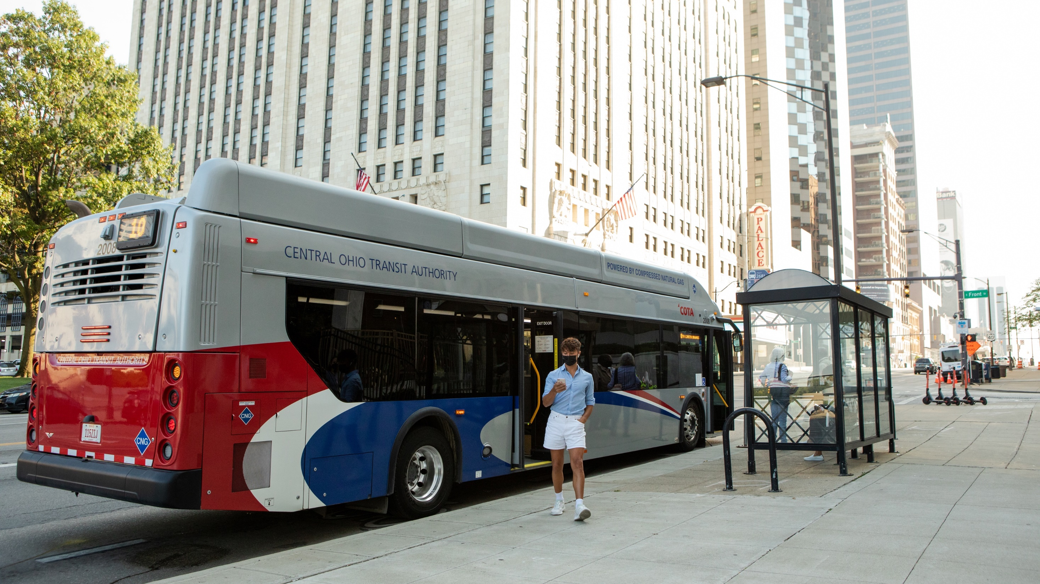
10
service
CHANGES
MOVING EVERY LIFE FORWARD |
The following service adjustments are proposed to begin on Monday, January 2, 2023.
No final decisions have been made for the January 2023 Service Change. Final changes will focus on reallocating resources based on need.

Slide 11
Frequency Adjustments
LINES | LINE NAME | CURRENT FREQUENCY | PROPOSED CHANGES
1 | Kenny / Livingston | Reduced frequency before 7am 15 minutes between Reynoldsburg and Riverside Hospital & 30 minutes between Riverside Hospital and Carriage Place on Saturday 20 minutes between Reynoldsburg and Riverside Hospital & 40 minutes between Riverside Hospital and Carriage Place on Sundays | 30 minutes the entire alignment on Saturday and Sunday No changes to weekday service
2 | E Main / N High | Reduced frequency before 7am 15 minutes between Westview Turnaround and Great Eastern & 30 minutes between Great Eastern and Main & Hanson on Saturday 20 minutes between Westview Turnaround and Great Eastern & 40 minutes between Great Eastern and Main & Hanson on Sunday | 30 minutes the entire alignment on Saturday and Sunday No changes to weekday service
10 | E Broad / W Broad | Reduced frequency before 7am 15 minutes between Westwoods and Mt Carmel East Hospital & 30 minutes between Mt Carmel and Limited Brands on Saturday 20 minutes between Westwoods and Mt Carmel East Hospital & 40 minutes between Mt Carmel and Limited Brands on Sunday | 30 minutes the entire alignment on Saturday and Sunday No changes to weekday service
CMAX |  | Reduced frequency before 7am 15 minutes between downtown and Northland Transit Center & 30 minutes between Northland and Westerville on Saturday​ 20 minutes between downtown and Northland Transit Center & 40 minutes between Northland and Westerville on Sunday | 30 minutes the entire alignment on Saturday and Sunday No changes to weekday service
Notes:
Methodology -Recommendations were made after reviewing trips on each line….removing singular trip will not have enough impact on reducing the amount operators needed

Slide 12
Frequency Adjustments
LINES | LINE NAME | CURRENT FREQUENCY | PROPOSED CHANGES
8 | Karl / S High / Parsons | 15 minutes between Boardwalk & Shapter and downtown & 30 minutes south of downtown seven days a week | 20 minutes between Boardwalk & Shapter and downtown & 40 minutes south of downtown Monday through Friday 30 minutes the entire alignment on Saturday and Sunday
22 | OSU-Rickenbacker | 15 minutes south of Broad Street and 30 minutes remainder Monday through Friday 30 minutes Saturday and 40 minutes Sunday | 15 minutes south of Broad Street and 30 minutes remainder Monday through Friday 30 minutes Saturday and Sunday No change to weekday service
33 | Henderson | 30 minutes between Broadmeadows and Sawmill Rd & 60 minutes to Olde Sawmill Square and Metrocenter seven days a week | 60 minutes between Broadmeadows and Sawmill Rd & 120 minutes to Olde Sawmill Square and Metrocenter on Saturday & Sunday only No change to weekday service
Disclaimer: Lines may be added or removed as on-time performance information becomes available.
All changes are proposed. No final decisions have been made for the January 2023 Service Change.

Slide 13
Facilitating Easy Transfers
30-MINUTE LINEUPS
SATURDAY & SUNDAY
All frequent lines would be reduced to run 30 minutes all day on Saturday & Sunday
LINES ​ | LINE NAME​ | FREQUENCY CHANGE​
1​ | ​Kenny / Livingston | 30 minutes Saturday/Sunday
2​ | ​E Main / N High | 30 minutes Saturday/Sunday
6​ | ​Sullivant | 30 minutes Saturday/Sunday
7 | Mt Vernon | 30 minutes Saturday/Sunday
8 | Karl / S High / Parsons | 30 minutes Saturday/Sunday
10​ | ​E Broad / W Broad | 30 minutes Saturday/Sunday
CMAX​ | ​ | 30 minutes Saturday/Sunday
Based on passenger feedback, COTA is proposing all day lineup's on Saturday and Sunday for local lines passing through downtown Columbus.
Lineups make transferring quick and easy and will minimize the amount of time a rider spends waiting on their connecting route. Local bus lines would meet near the intersection of Spring Street Terminal every 30 or 60 minutes.
60-MINUTE LINEUPS
SATURDAY & SUNDAY
All frequent lines would be reduced to run 30 minutes all day on Saturday & Sunday
LINES ​ | LINE NAME​ | FREQUENCY CHANGE​
3​ | ​Northwest / Harrisburg | 60 minutes Saturday/Sunday
4​ | ​Indianola / Lockbourne | 60 minutes Saturday/Sunday
5​ | ​W 5th Ave / Refugee | 60 minutes Saturday/Sunday
9 | W Mound / Brentnell | 60 minutes Saturday/Sunday
11 | Bryden / Maize | 60 minutes Saturday/Sunday
102 | N High / Polaris Pkwy | 60 minutes Saturday/Sunday

Slide 14
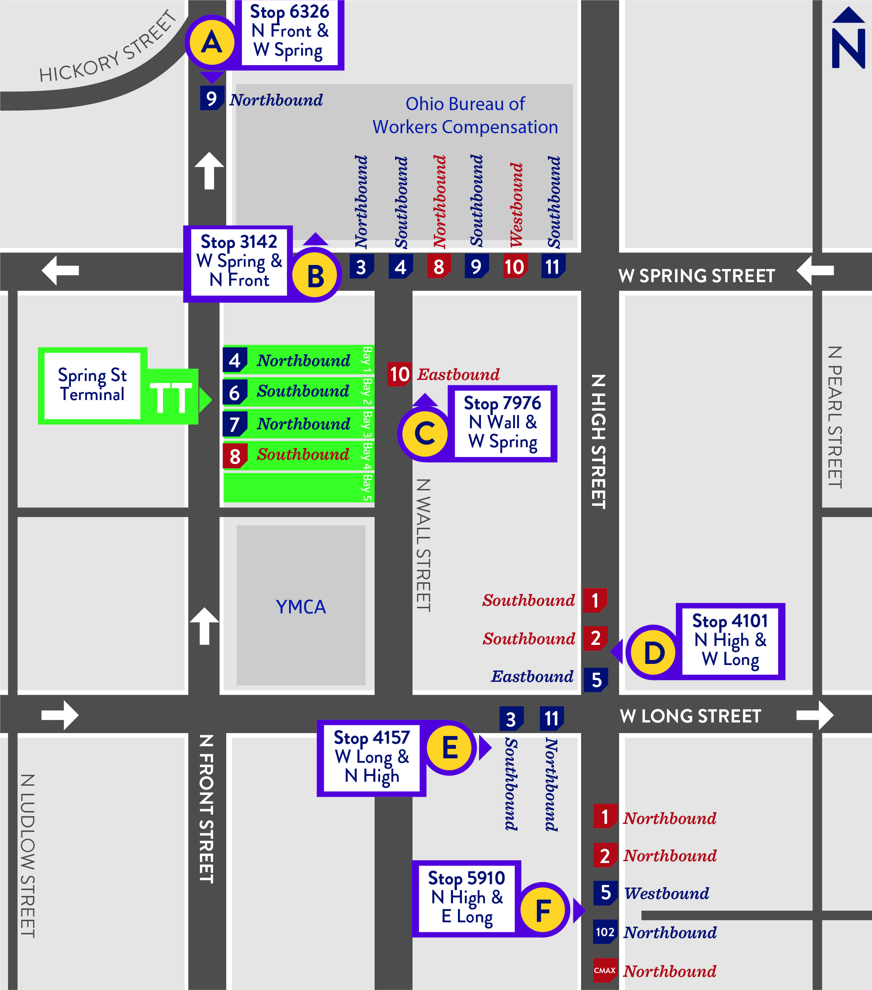
Facilitating Easy Transfers
LOCAL LINES WILL LINEUP NEAR
SPRING STREET TERMINAL
Based on passenger feedback, COTA is proposing all day lineup's on Saturday and Sunday for local lines passing through downtown Columbus.
Lineups make transferring quick and easy and will minimize the amount of time a rider spends waiting on their connecting route. Local bus lines would meet near the intersection of Spring Street Terminal every 30 or 60 minutes.

Slide 15
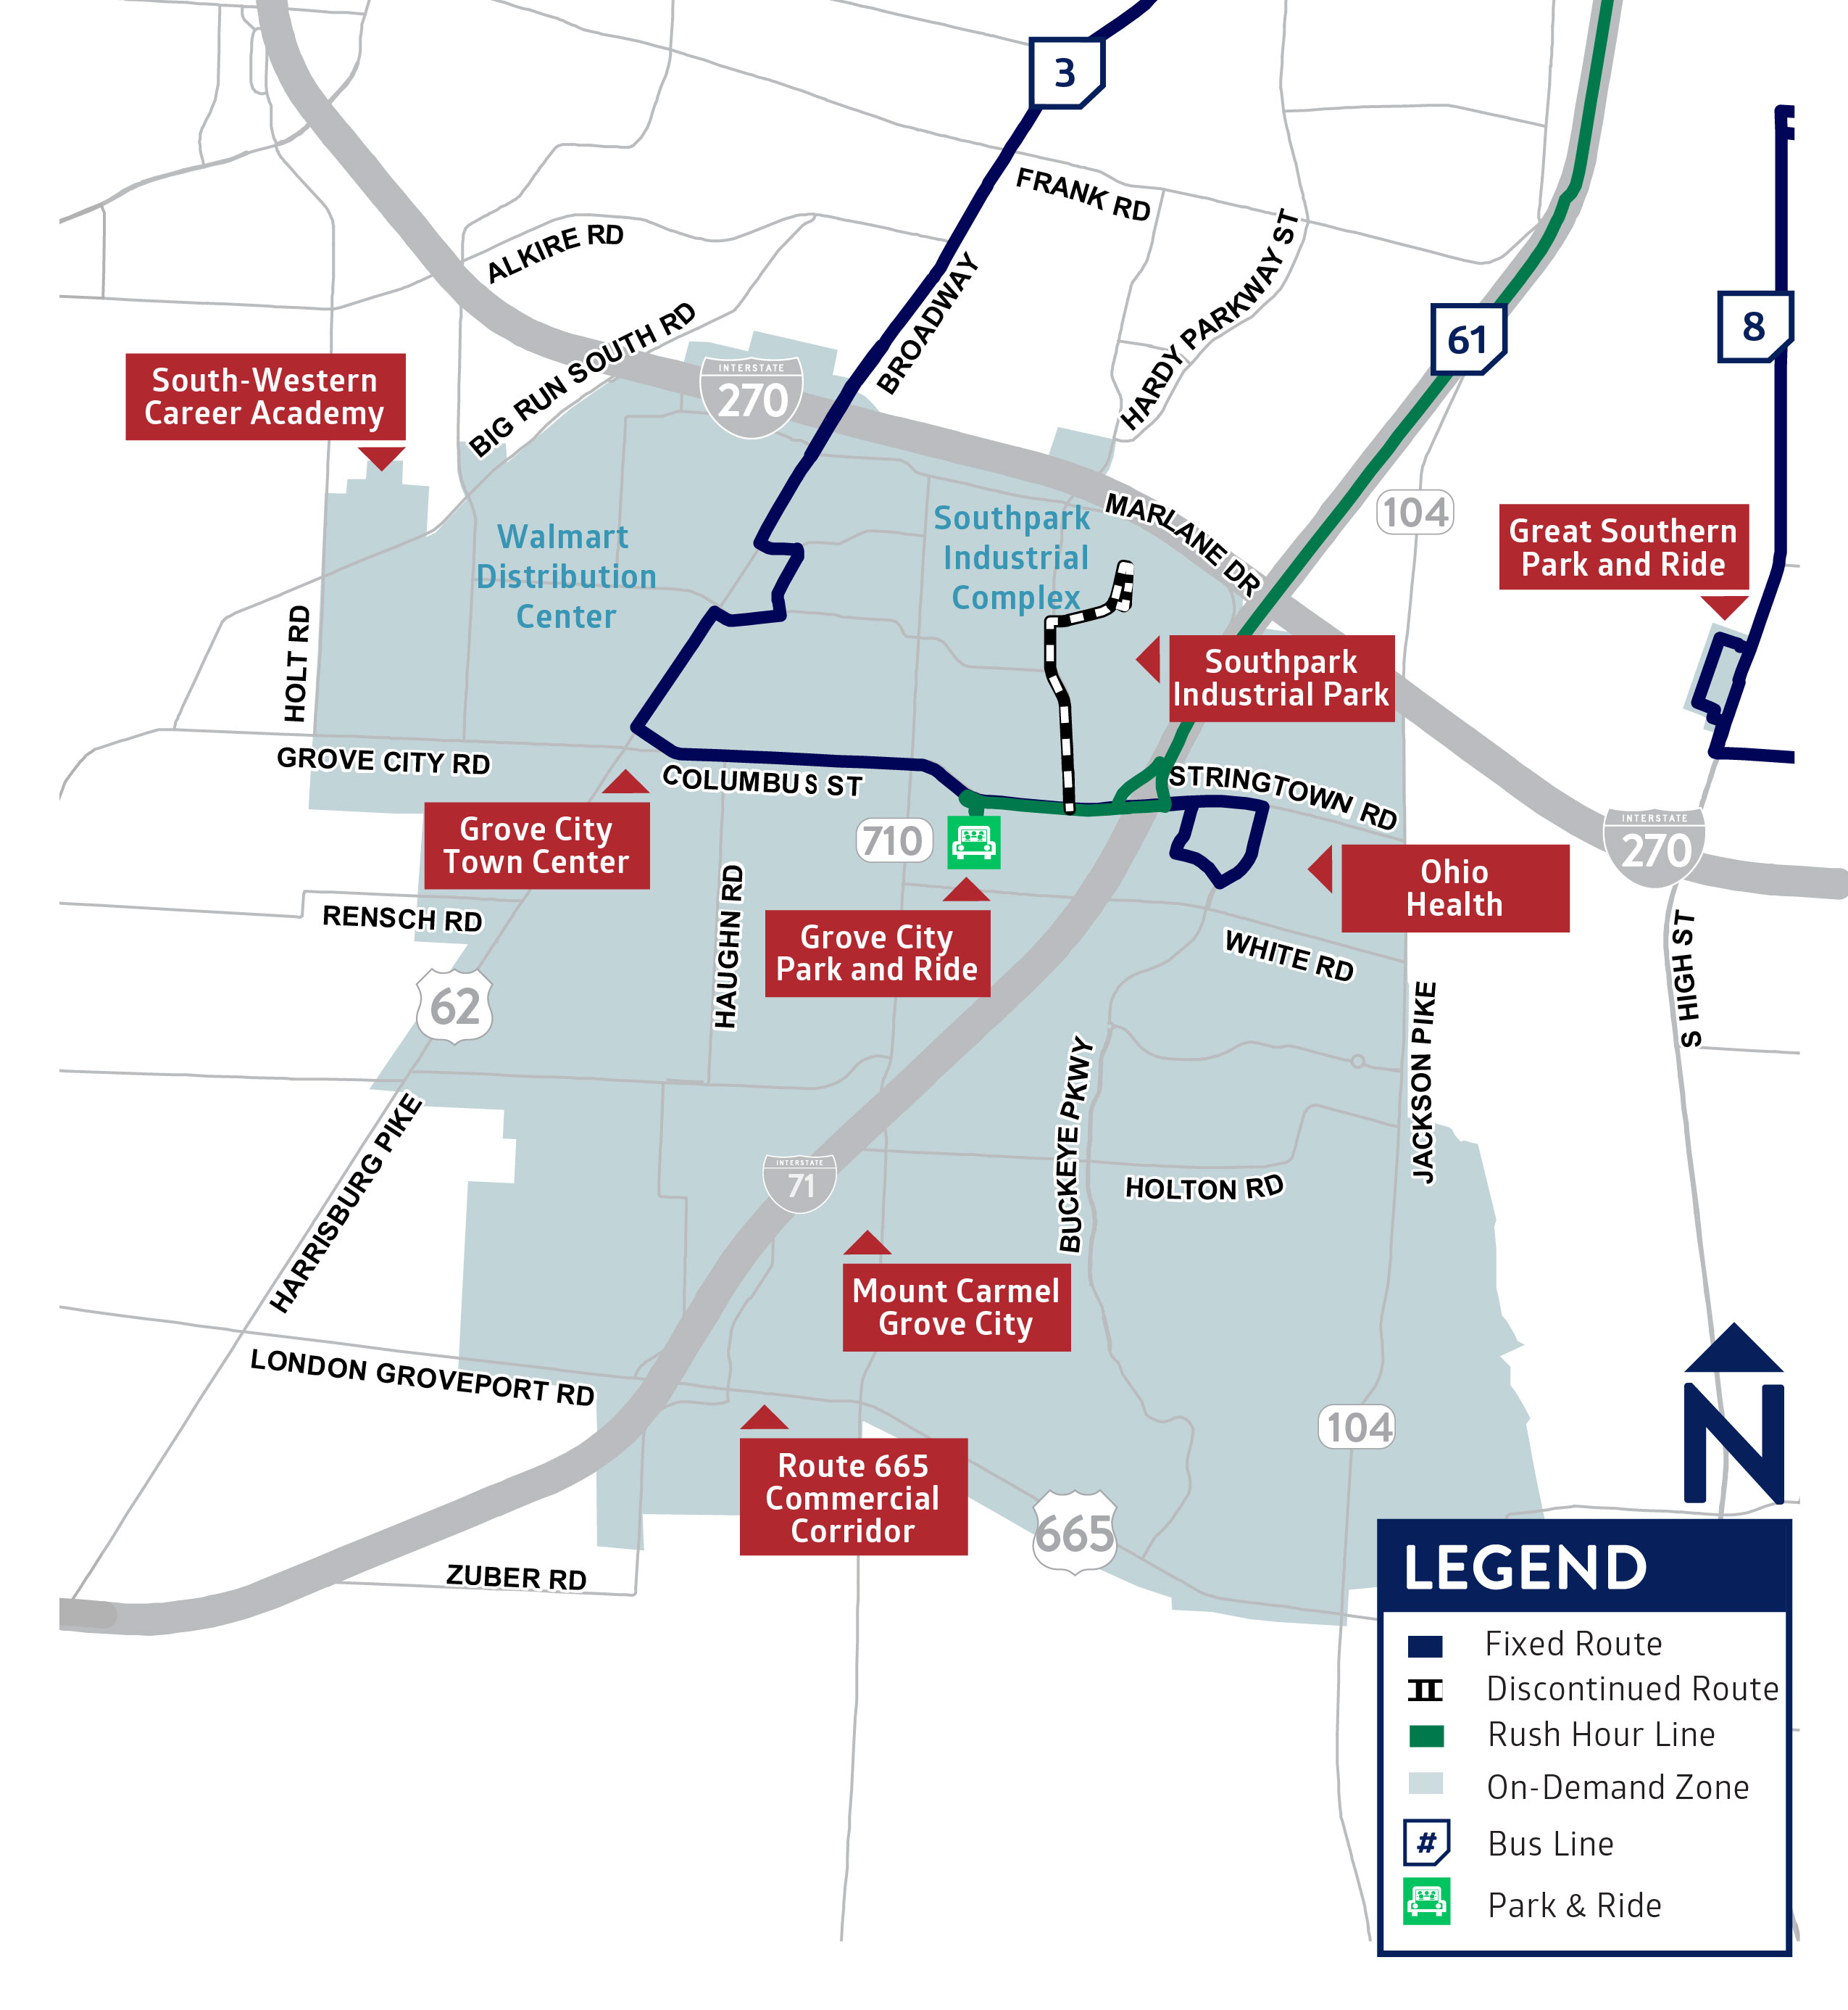
Line 61 Routing Change
Due to historically low ridership, COTA is proposing to remove Line 61 from Gantz Rd. This realignment will provide a simple, more direct route to and from Grove City Park and Ride.
Instead, Line 61 would remain on Stringtown Rd in both directions. Stops along Gantz Rd and Southpark Pl would permanently close.
Customers impacted by this change are encouraged to use COTA//Plus Grove City zone for travel into Southpark Industrial Complex. COTA//Plus Grove City operates from 5:30am to 8:00pm Monday through Friday. Customers can request a ride using the COTA//Plus mobile app.
MOVING EVERY LIFE FORWARD |
Notes:
Customers impacted by this change are encouraged to use COTA//Plus South Side zone.

Slide 16
Q&A Chat
How to join the conversation
If joining by WebEx, submit comments via the chat box.
If joining by phone, please wait to unmute yourself until directed by the moderator.
If joining by Facebook Live, please comment your questions in the livestream.
If joining in-person there will be an opportunity to speak at the podium for up to 3 minutes. You may also fill out a comment card or speak with staff one-on-one after the meeting.
Have a question or comment that wasn't addressed today?
Visit cota.com/contact or call 614-228-1776.
Final service changes will be announced at the December Public Meetings
Thursday, December 8 at 6pm
Tuesday, December 13 at noon

Slide 17
MOVING EVERY LIFE FORWARD
COTA.COM

Slide 18
COTA’s new Way to Pay
In November 2021, COTA launched our partnership with the Transit app. This mobile app offers a revolutionary new way to plan, track and pay for COTA rides, making our mobility solutions more affordable, accessible and safe.
MOVING EVERY LIFE FORWARD |
BENEFITS
Fare capping $4.50/day and $62/month
Simplified two-hour fares
Network of up to 350 retailers where customers can load funds to their COTA accounts
COTA Smartcards available for those without smartphones

Slide 19
Income Assistance Pilot Program
MOVING EVERY LIFE FORWARD |
COTA’s Board of Trustees approved a 6-month pilot program that extends eligibility for transit discounts to individuals who receive public income assistance.
Launched March 1
Proof of participation accepted
SNAP
Publicly funded childcare
Ohio Works First cash assistance
Prevention, Retention and Contingency emergency assistance
Medicaid
Temporary Assistance to Needy Families
Notes:
March 1 – September 1

Slide 20
Transit Amenity Contribution Program
COTA launched a new program that invites customers to be a part of improving the mobility experience. Through the new program, customers can:
MOVING EVERY LIFE FORWARD |
Request an Amenity Customers can request replacements and repairs for amenities including trash cans, benches, shelters and lights at a transit stop.
Contribute Toward a New Amenity You can help improve the mobility experience in your neighborhood by contributing toward a new amenity.
Adopt-A-Stop When you or your organization signs up to Adopt-a-Stop, you agree to help pick up litter and empty the COTA-provided trash receptacles at the adopted location.

Slide 21
Summary of Changes
Exluding Line 8, there will be no change to weekday service
LINES | LINE NAME | CHANGES
1 | Kenny / Livingston | Frequency reduction on weekend
2 | N High / E Main | Frequency reduction on weekend
3 | Northwest / Harrisburg | Lineups on weekend
4 | Indianola / Lockbourne | Lineups on weekend
5 | W 5th Ave / Refugee | Lineups and frequency reduction on weekend
6 | Sullivant | Lineups on weekend
7 | Mt Vernon | Lineups and frequency reduction on weekend
8 | Karl / S High / Parsons | Frequency reduction
LINES | LINE NAME | CHANGES
9 | W Mound / Brentnell | Lineups on weekend
10 | E Broad / W Broad | Frequency reduction on weekend
11 | Bryden / Maize | Lineups on weekend
22 | James-Stelzer | Frequency improvement on weekends
33 | Henderson | Frequency reduction on weekend
61 | Grove City | Minor realignment
102 | N High / Polaris Pkwy | Lineups on weekend
CMAX |  | Frequency reduction on weekend
MOVING EVERY LIFE FORWARD |
Disclaimer: Lines may be added or removed as on-time performance information becomes available.

